Slide 1

1. Title Page
Notes:
textbox
No alt text provided
textbox
No alt text provided
slicer
No alt text provided
image
No alt text provided
slicer
No alt text provided
image
No alt text provided

Slide 2
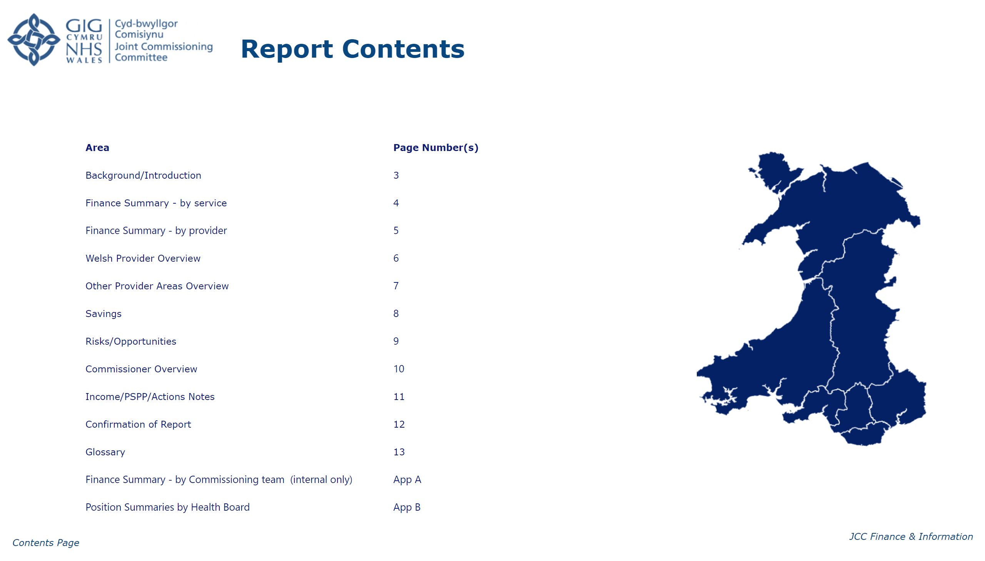
2. Report Contents
Notes:
textbox
No alt text provided
image
No alt text provided
textbox
No alt text provided
image
No alt text provided
textbox
No alt text provided
textbox
No alt text provided
textbox
No alt text provided

Slide 3
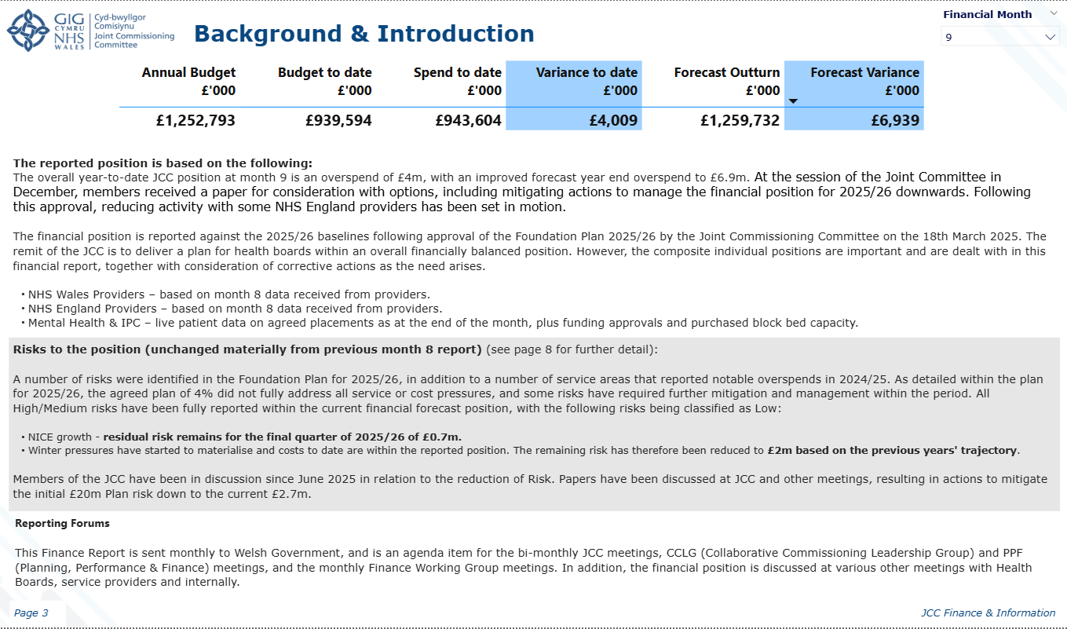
3. Background/Introduction
Notes:
textbox
No alt text provided
image
No alt text provided
textbox
No alt text provided
slicer
No alt text provided
slicer
No alt text provided
tableEx
No alt text provided
textbox
No alt text provided
textbox
No alt text provided
textbox
No alt text provided
textbox
No alt text provided
shape
No alt text provided

Slide 4
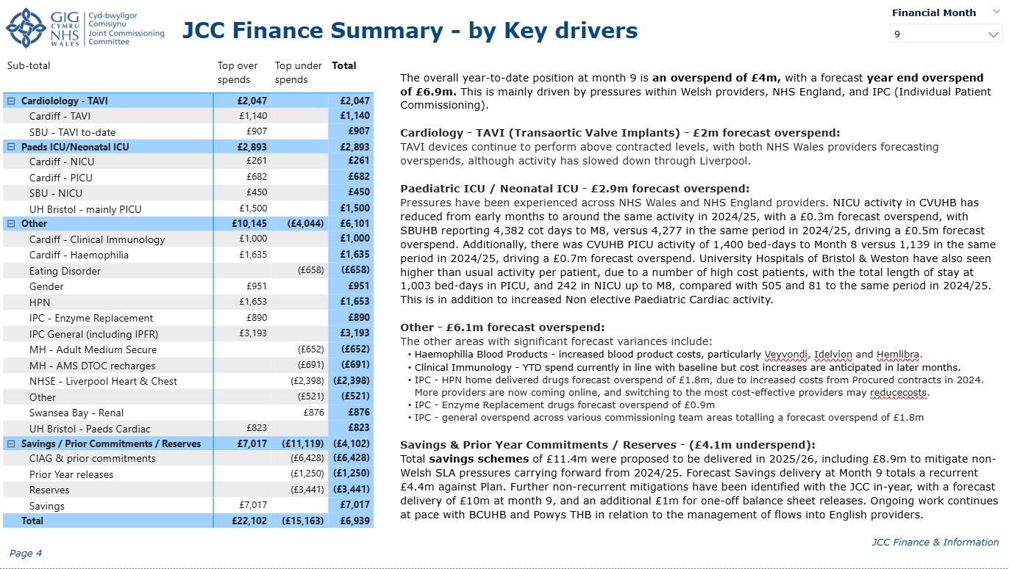
4. Finance Summary - by service
Notes:
textbox
No alt text provided
image
No alt text provided
textbox
No alt text provided
slicer
No alt text provided
slicer
No alt text provided
textbox
No alt text provided
textbox
No alt text provided
textbox
No alt text provided
textbox
No alt text provided
shape
No alt text provided
pivotTable
No alt text provided

Slide 5
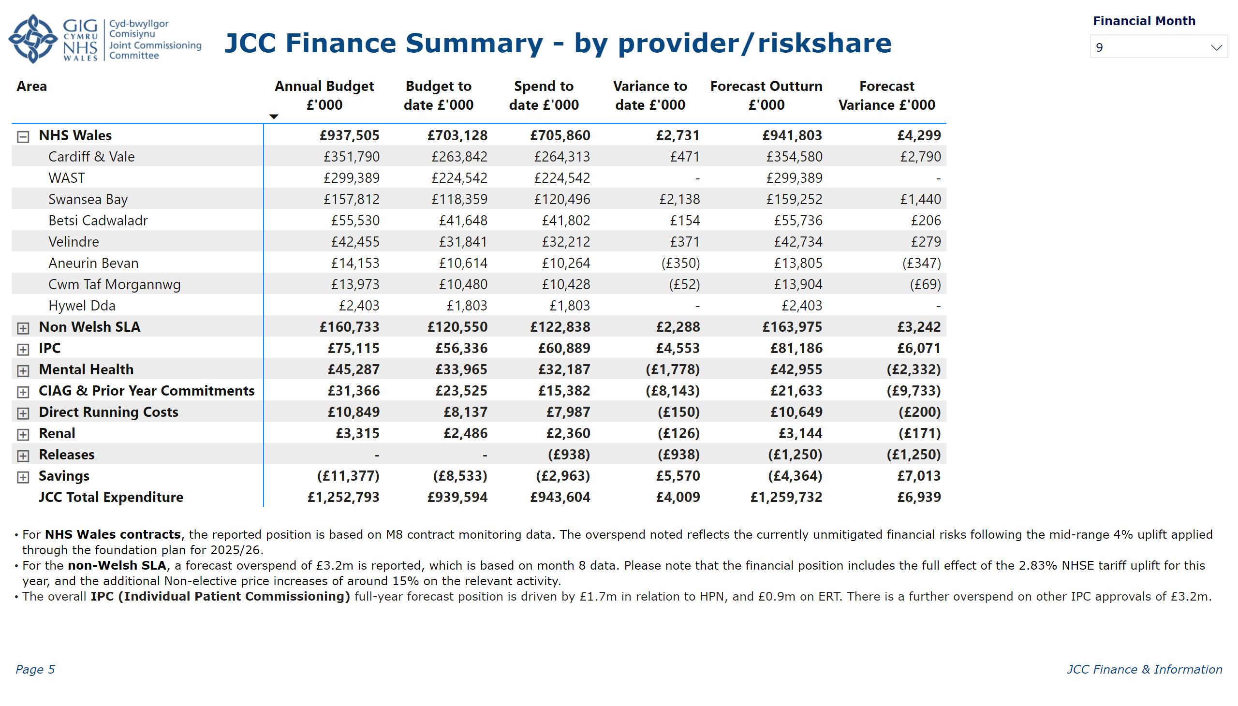
5. Finance Summary - by provider
Notes:
textbox
No alt text provided
image
No alt text provided
textbox
No alt text provided
slicer
No alt text provided
slicer
No alt text provided
pivotTable
No alt text provided
textbox
No alt text provided
textbox
No alt text provided
textbox
No alt text provided
textbox
No alt text provided
shape
No alt text provided
shape
No alt text provided

Slide 6
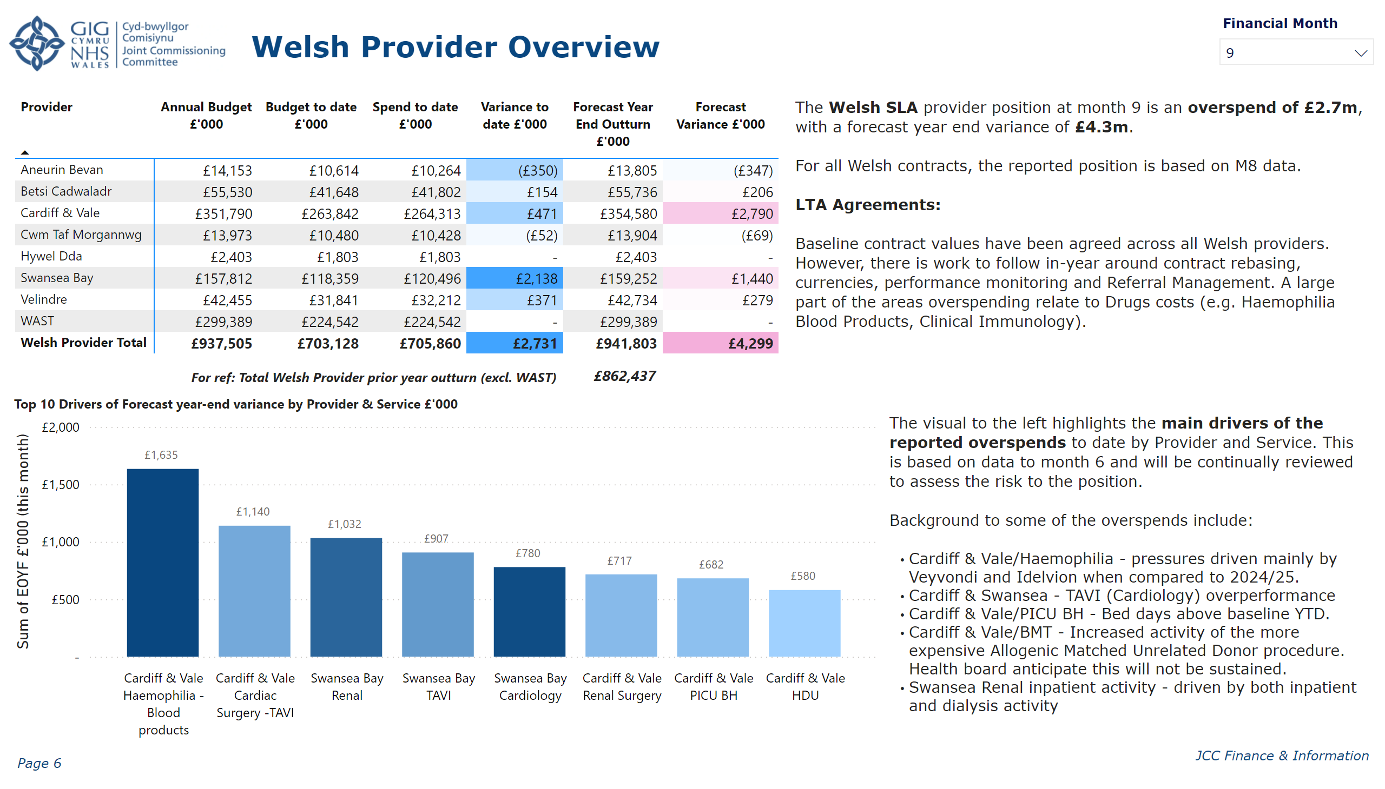
6. Welsh Provider Overview
Notes:
image
No alt text provided
textbox
No alt text provided
pivotTable
No alt text provided
textbox
No alt text provided
textbox
No alt text provided
slicer
No alt text provided
slicer
No alt text provided
Top 10 Drivers of Forecast year-end variance by Provider & Service £'000
No alt text provided
card
No alt text provided
textbox
No alt text provided
textbox
No alt text provided
textbox
No alt text provided
shape
No alt text provided

Slide 7
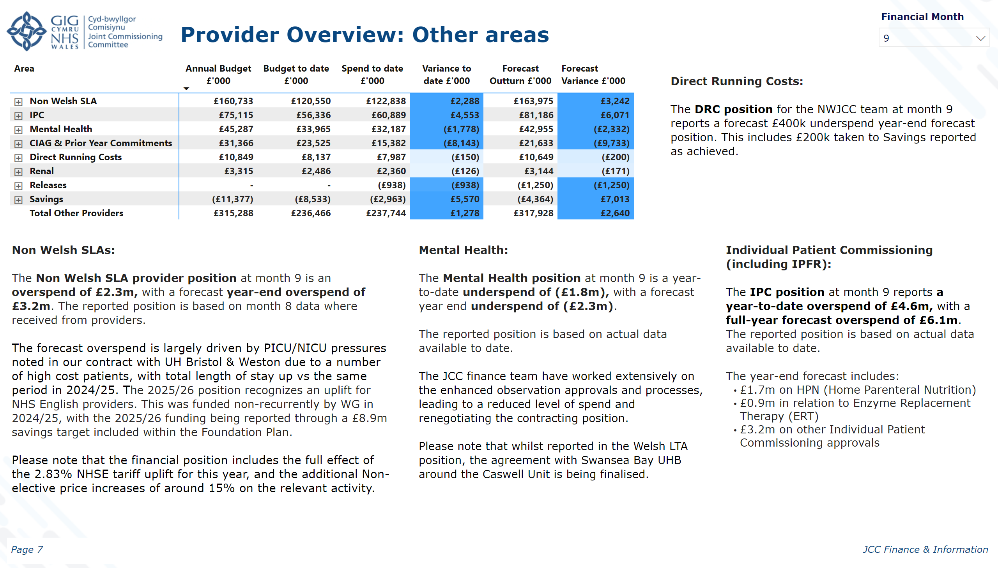
7. Overview: Other Provider areas
Notes:
textbox
No alt text provided
image
No alt text provided
textbox
No alt text provided
slicer
No alt text provided
slicer
No alt text provided
textbox
No alt text provided
card
No alt text provided
textbox
No alt text provided
textbox
No alt text provided
textbox
No alt text provided
textbox
No alt text provided
pivotTable
No alt text provided
textbox
No alt text provided
textbox
No alt text provided
textbox
No alt text provided
shape
No alt text provided

Slide 8
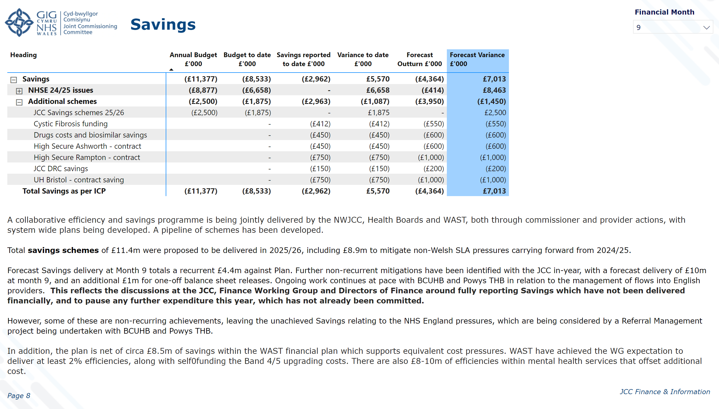
8. Savings
Notes:
textbox
No alt text provided
image
No alt text provided
textbox
No alt text provided
slicer
No alt text provided
slicer
No alt text provided
pivotTable
No alt text provided
textbox
No alt text provided
textbox
No alt text provided
shape
No alt text provided

Slide 9
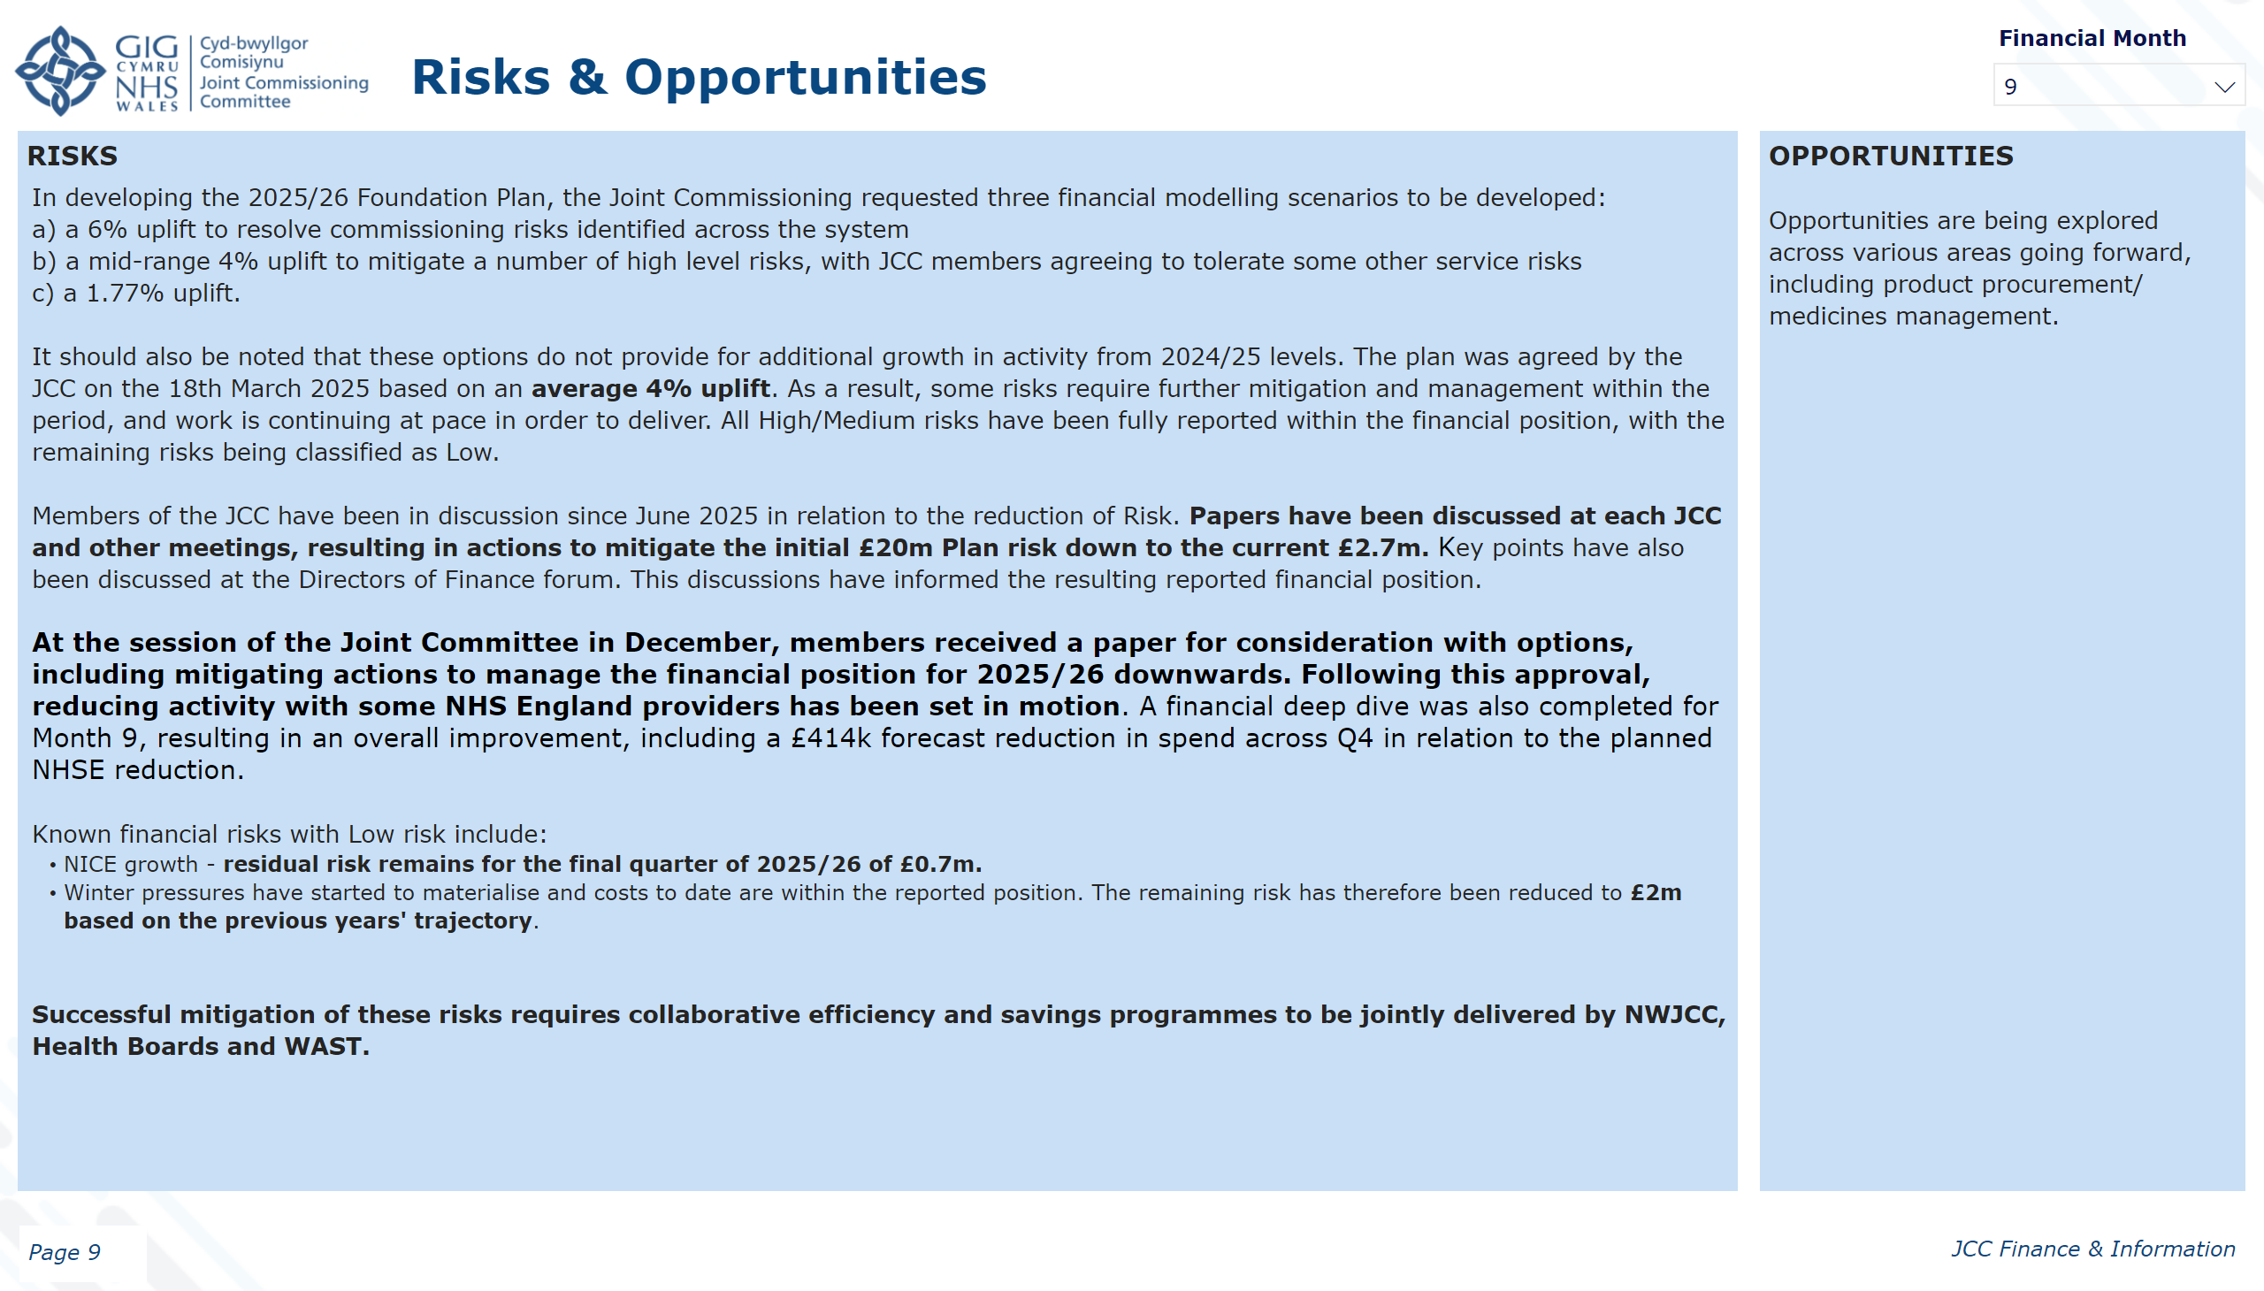
9. Risks/Opportunities
Notes:
textbox
No alt text provided
image
No alt text provided
textbox
No alt text provided
slicer
No alt text provided
slicer
No alt text provided
textbox
No alt text provided
pivotTable
No alt text provided
textbox
No alt text provided
textbox
No alt text provided
textbox
No alt text provided
shape
No alt text provided

Slide 10
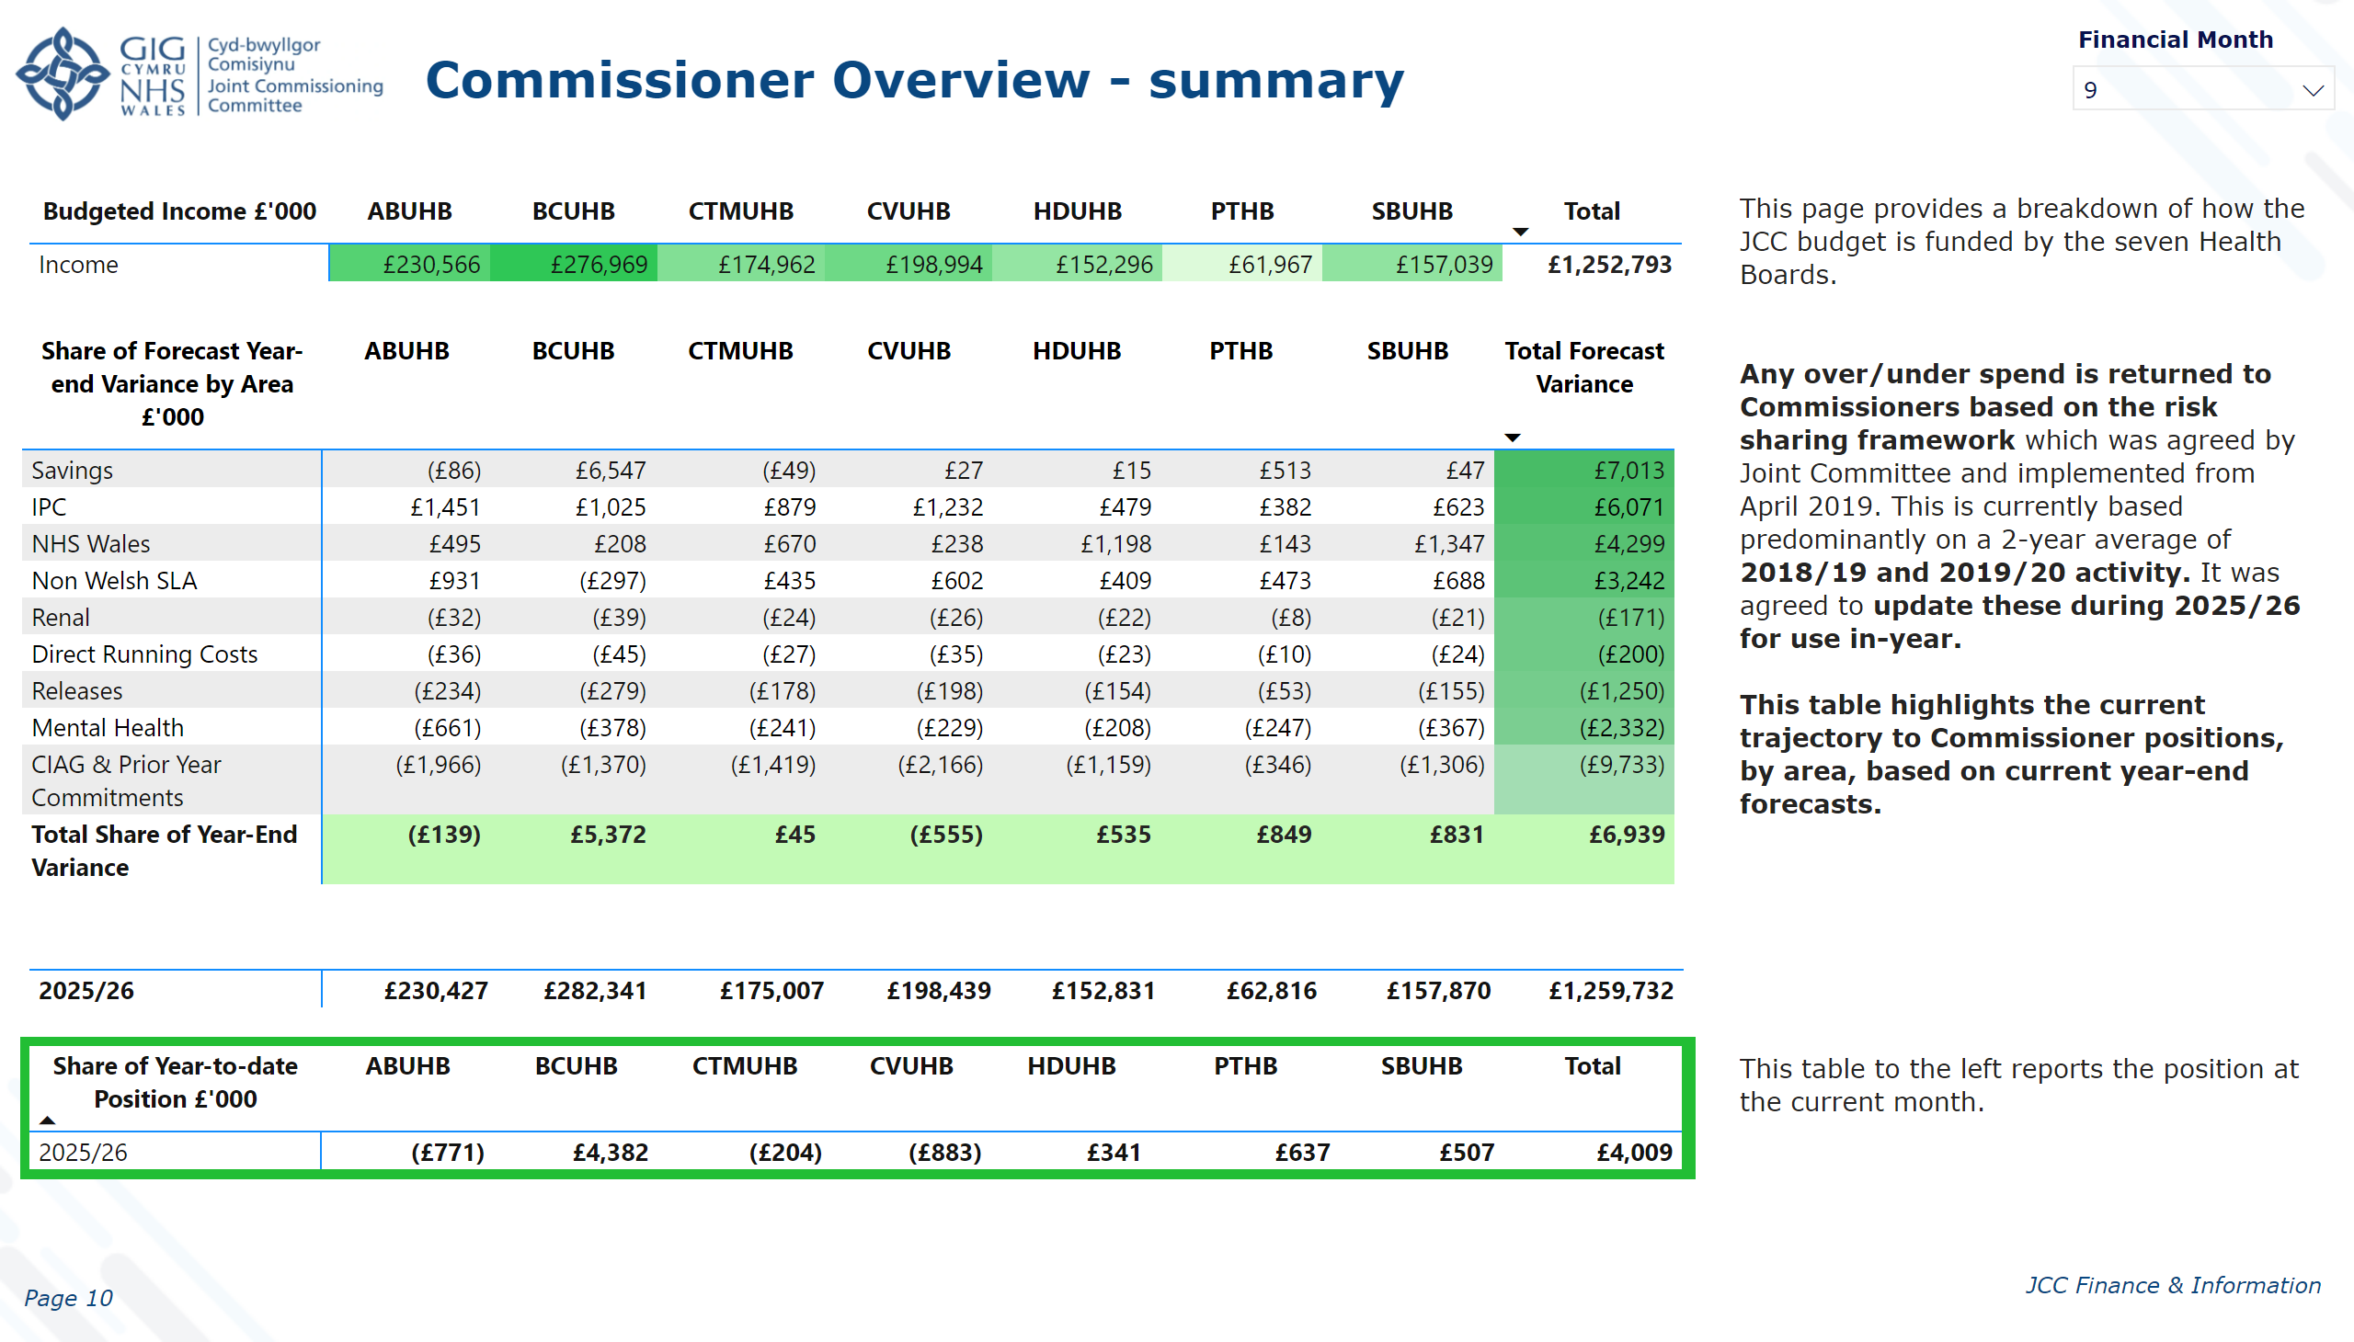
10. Commissioner Overview
Notes:
textbox
No alt text provided
image
No alt text provided
textbox
No alt text provided
slicer
No alt text provided
slicer
No alt text provided
pivotTable
No alt text provided
pivotTable
No alt text provided
Total Forecast Income including Forecast year-end variance
No alt text provided
textbox
No alt text provided
textbox
No alt text provided
Share of Year-to-date Position £'000
No alt text provided
shape
No alt text provided

Slide 11
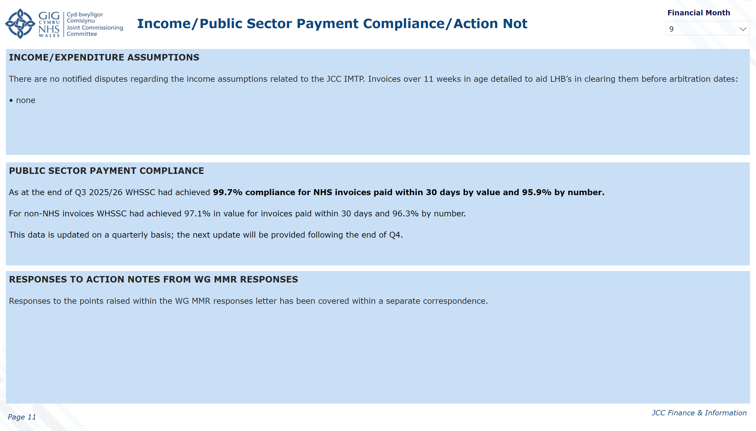
11. Income/PSPP/Action Notes
Notes:
textbox
No alt text provided
image
No alt text provided
textbox
No alt text provided
slicer
No alt text provided
slicer
No alt text provided
textbox
No alt text provided
textbox
No alt text provided
textbox
No alt text provided
textbox
No alt text provided
shape
No alt text provided

Slide 12

12. Confirmation of Report
Notes:
textbox
No alt text provided
image
No alt text provided
textbox
No alt text provided
slicer
No alt text provided
slicer
No alt text provided
textbox
No alt text provided
textbox
No alt text provided
image
No alt text provided
image
No alt text provided
image
No alt text provided
shape
No alt text provided

Slide 13

13. Glossary
Notes:
textbox
No alt text provided
image
No alt text provided
textbox
No alt text provided
slicer
No alt text provided
slicer
No alt text provided
textbox
No alt text provided
textbox
No alt text provided
shape
No alt text provided

Slide 14
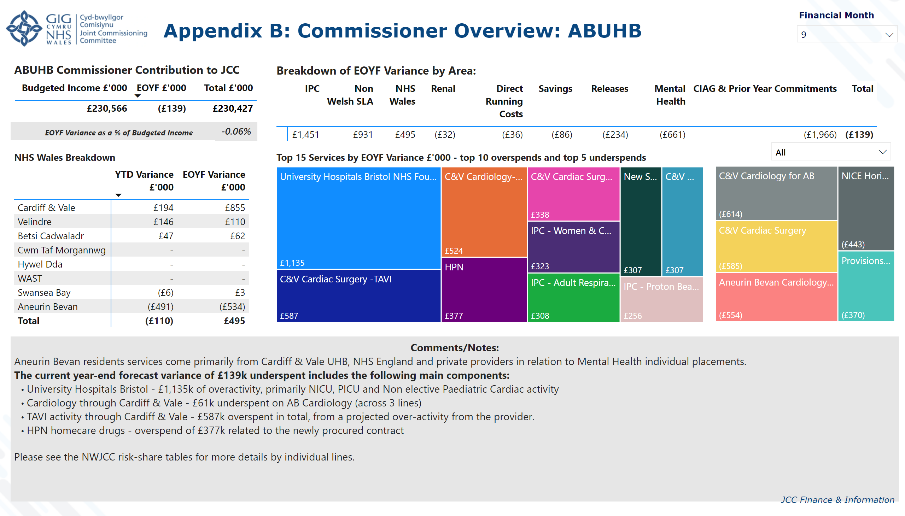
App B. Commissioner: ABUHB
Notes:
textbox
No alt text provided
image
No alt text provided
textbox
No alt text provided
slicer
No alt text provided
slicer
No alt text provided
ABUHB Commissioner Contribution to JCC
No alt text provided
NHS Wales Breakdown
No alt text provided
Breakdown of EOYF Variance by Area:
No alt text provided
Top 15 Services by EOYF Variance £'000 - top 10 overspends and top 5 underspends
No alt text provided
slicer
No alt text provided
card
No alt text provided
textbox
No alt text provided
textbox
No alt text provided
Top 15 Services by EOYF Variance £'000
No alt text provided
shape
No alt text provided

Slide 15
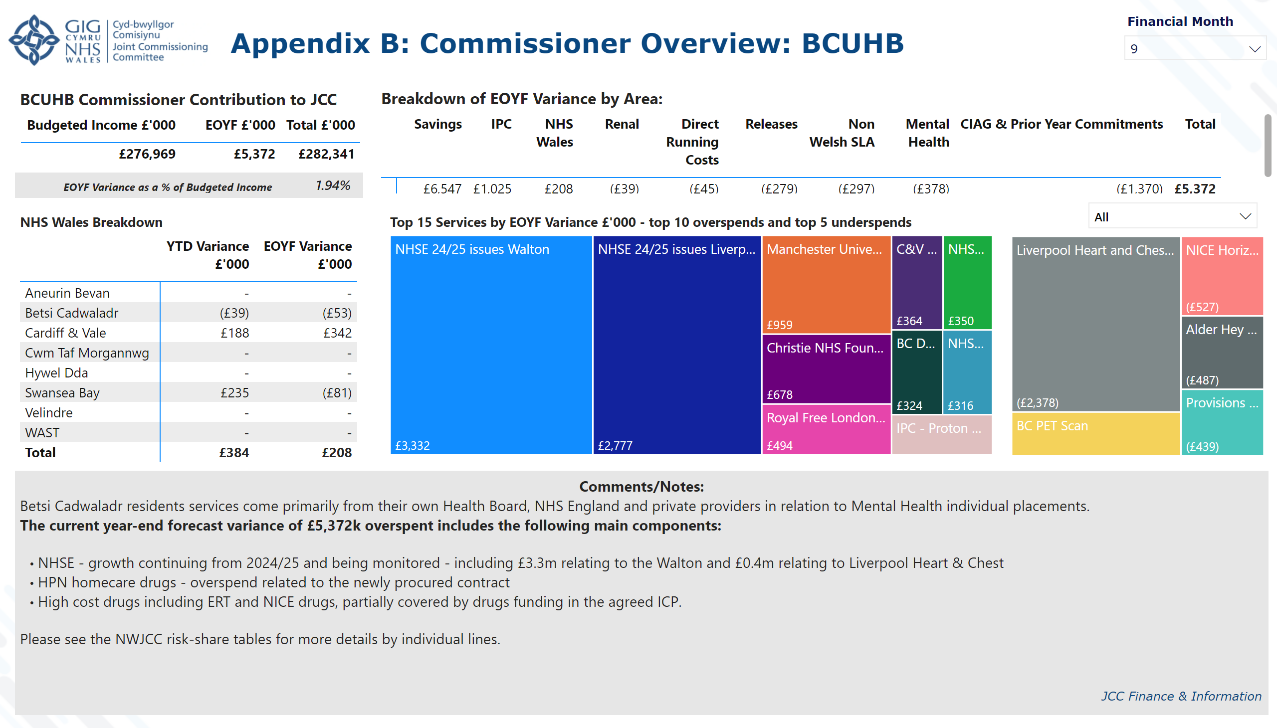
App B. Commissioner: BCUHB
Notes:
textbox
No alt text provided
image
No alt text provided
textbox
No alt text provided
slicer
No alt text provided
slicer
No alt text provided
BCUHB Commissioner Contribution to JCC
No alt text provided
NHS Wales Breakdown
No alt text provided
Breakdown of EOYF Variance by Area:
No alt text provided
slicer
No alt text provided
card
No alt text provided
textbox
No alt text provided
textbox
No alt text provided
Top 15 Services by EOYF Variance £'000 - top 10 overspends and top 5 underspends
No alt text provided
Top 15 Services by EOYF Variance £'000
No alt text provided
shape
No alt text provided

Slide 16
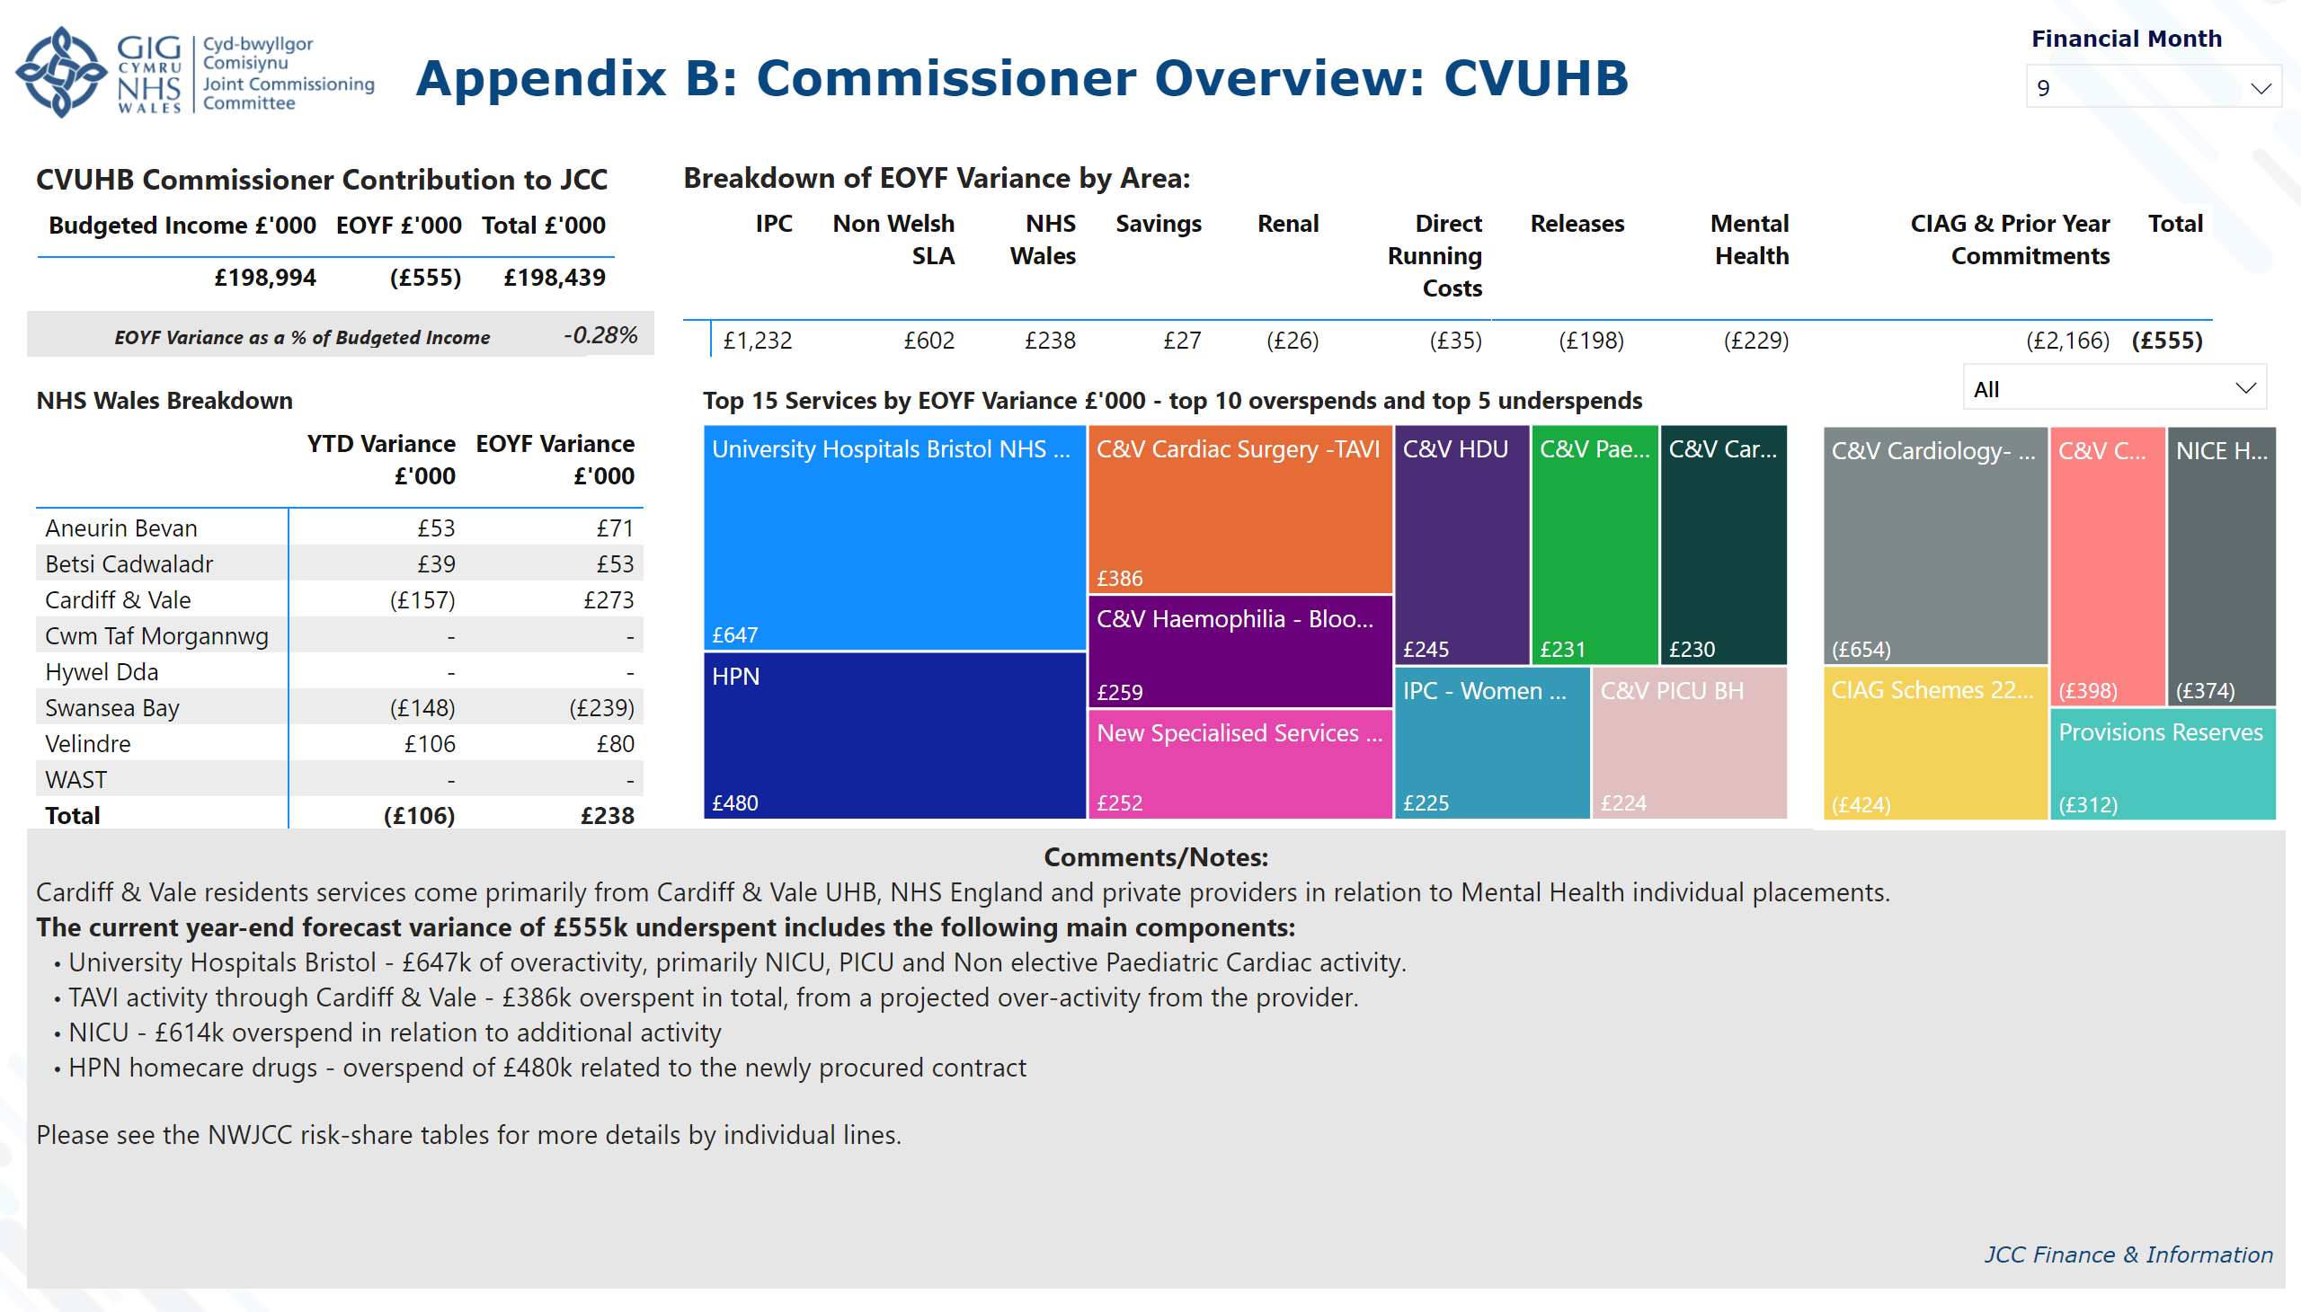
App B. Commissioner: C&V
Notes:
textbox
No alt text provided
image
No alt text provided
textbox
No alt text provided
slicer
No alt text provided
slicer
No alt text provided
CVUHB Commissioner Contribution to JCC
No alt text provided
NHS Wales Breakdown
No alt text provided
Breakdown of EOYF Variance by Area:
No alt text provided
slicer
No alt text provided
card
No alt text provided
textbox
No alt text provided
textbox
No alt text provided
Top 15 Services by EOYF Variance £'000 - top 10 overspends and top 5 underspends
No alt text provided
Top 15 Services by EOYF Variance £'000
No alt text provided
shape
No alt text provided

Slide 17
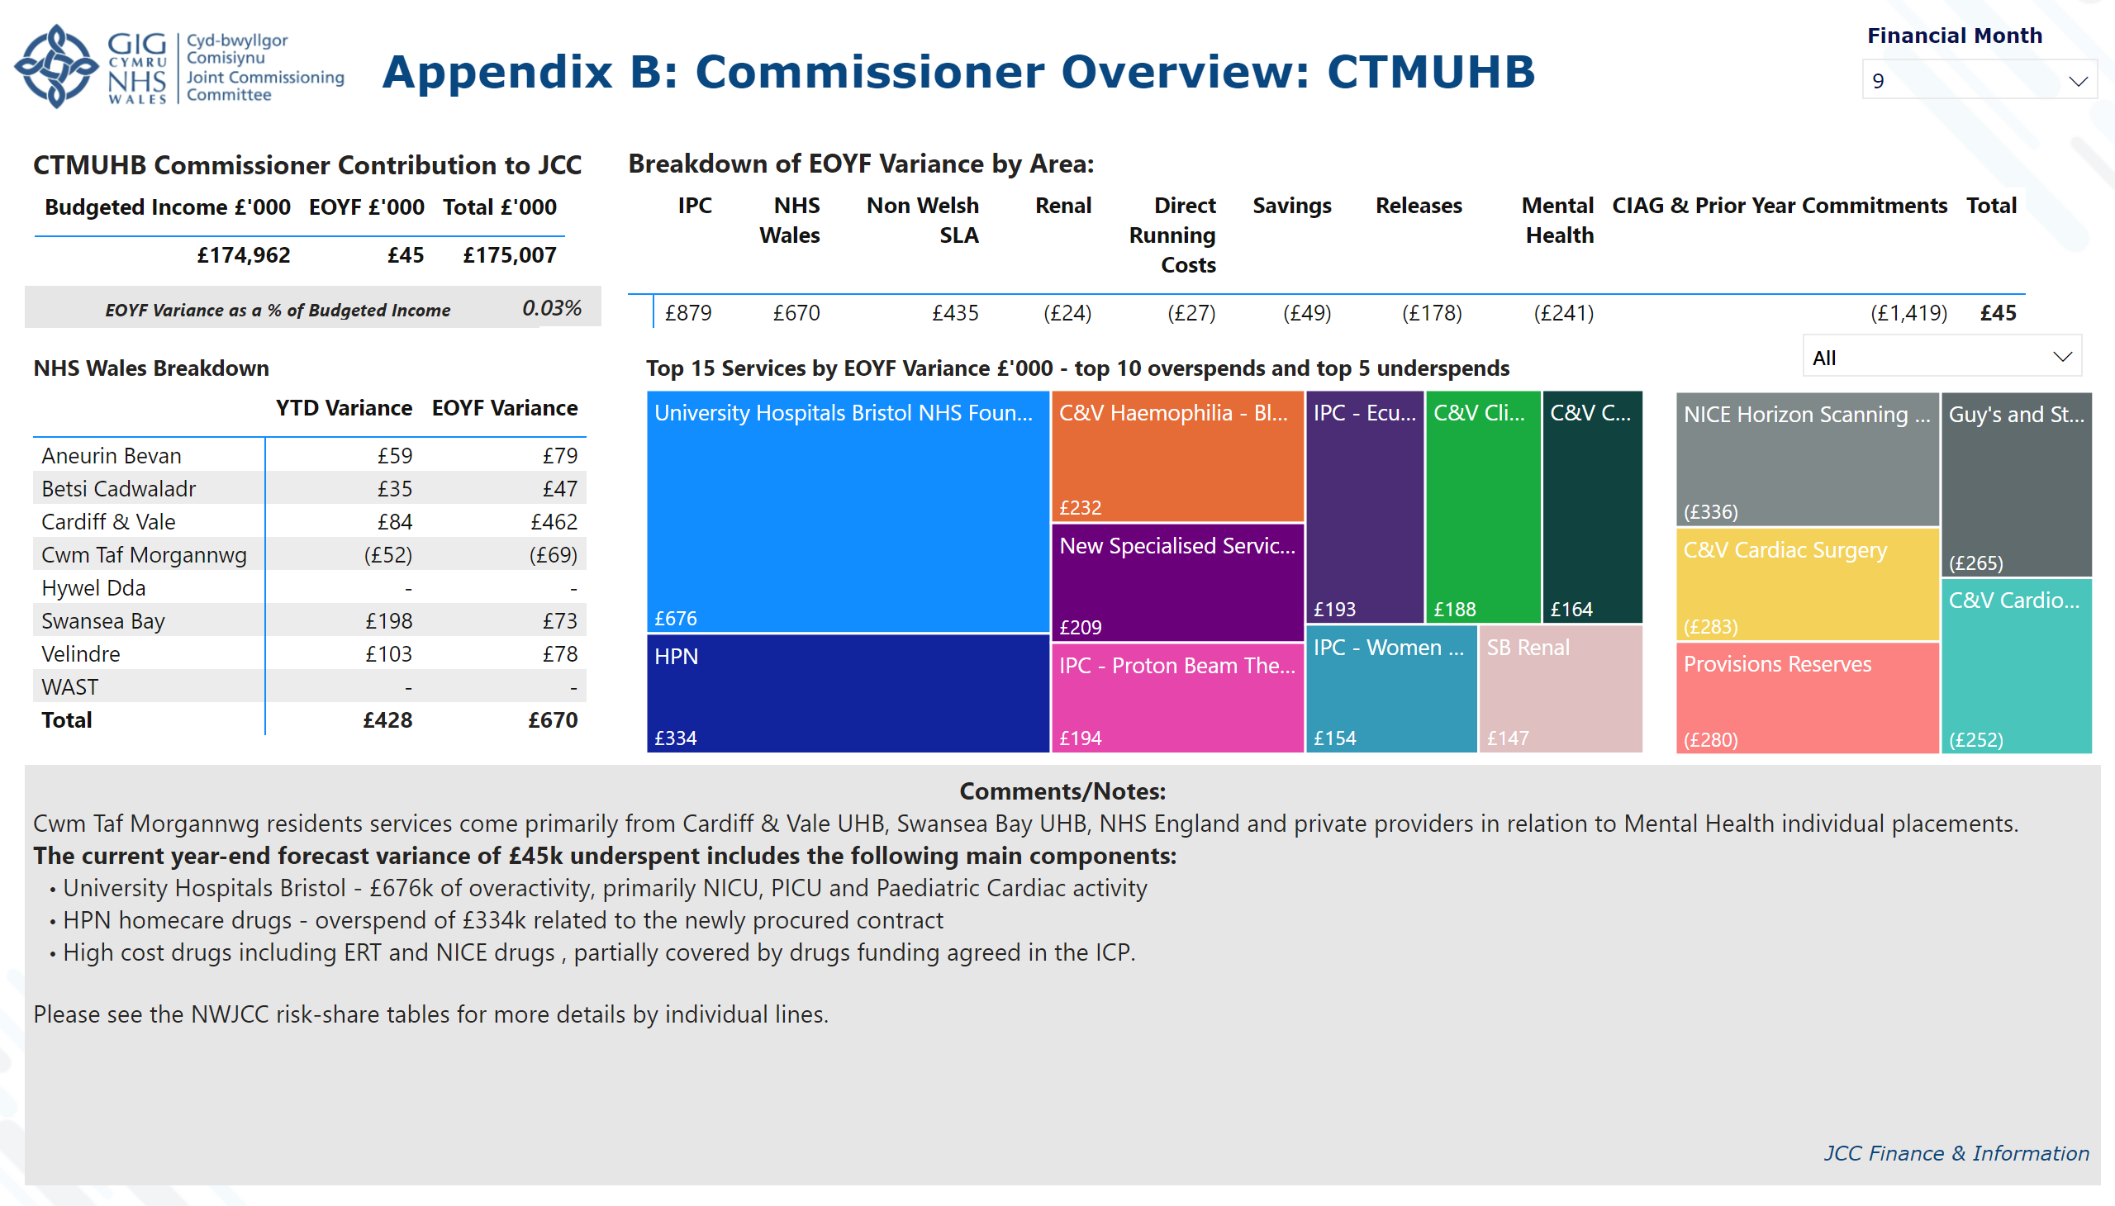
App B. Commissioner: CTM
Notes:
textbox
No alt text provided
image
No alt text provided
textbox
No alt text provided
slicer
No alt text provided
slicer
No alt text provided
CTMUHB Commissioner Contribution to JCC
No alt text provided
NHS Wales Breakdown
No alt text provided
Breakdown of EOYF Variance by Area:
No alt text provided
slicer
No alt text provided
card
No alt text provided
textbox
No alt text provided
textbox
No alt text provided
Top 15 Services by EOYF Variance £'000 - top 10 overspends and top 5 underspends
No alt text provided
Top 15 Services by EOYF Variance £'000
No alt text provided
shape
No alt text provided

Slide 18
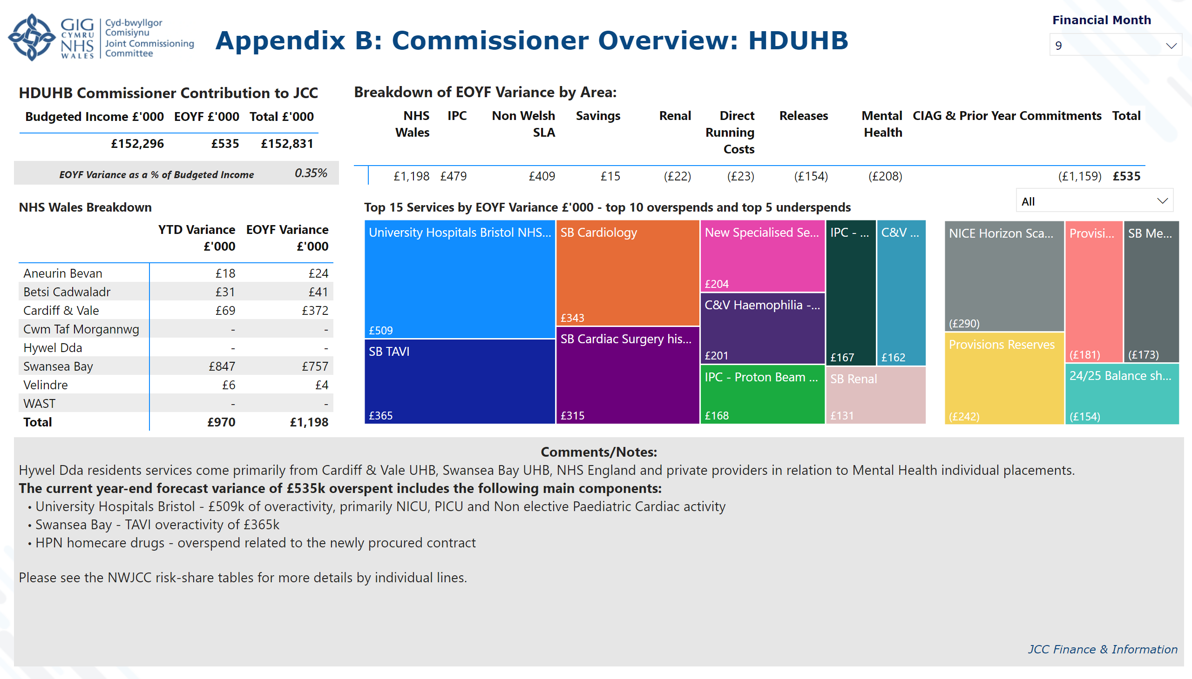
App B. Commissioner: HDUHB
Notes:
textbox
No alt text provided
image
No alt text provided
textbox
No alt text provided
slicer
No alt text provided
slicer
No alt text provided
HDUHB Commissioner Contribution to JCC
No alt text provided
NHS Wales Breakdown
No alt text provided
Breakdown of EOYF Variance by Area:
No alt text provided
slicer
No alt text provided
card
No alt text provided
textbox
No alt text provided
textbox
No alt text provided
Top 15 Services by EOYF Variance £'000 - top 10 overspends and top 5 underspends
No alt text provided
Top 15 Services by EOYF Variance £'000
No alt text provided
shape
No alt text provided

Slide 19
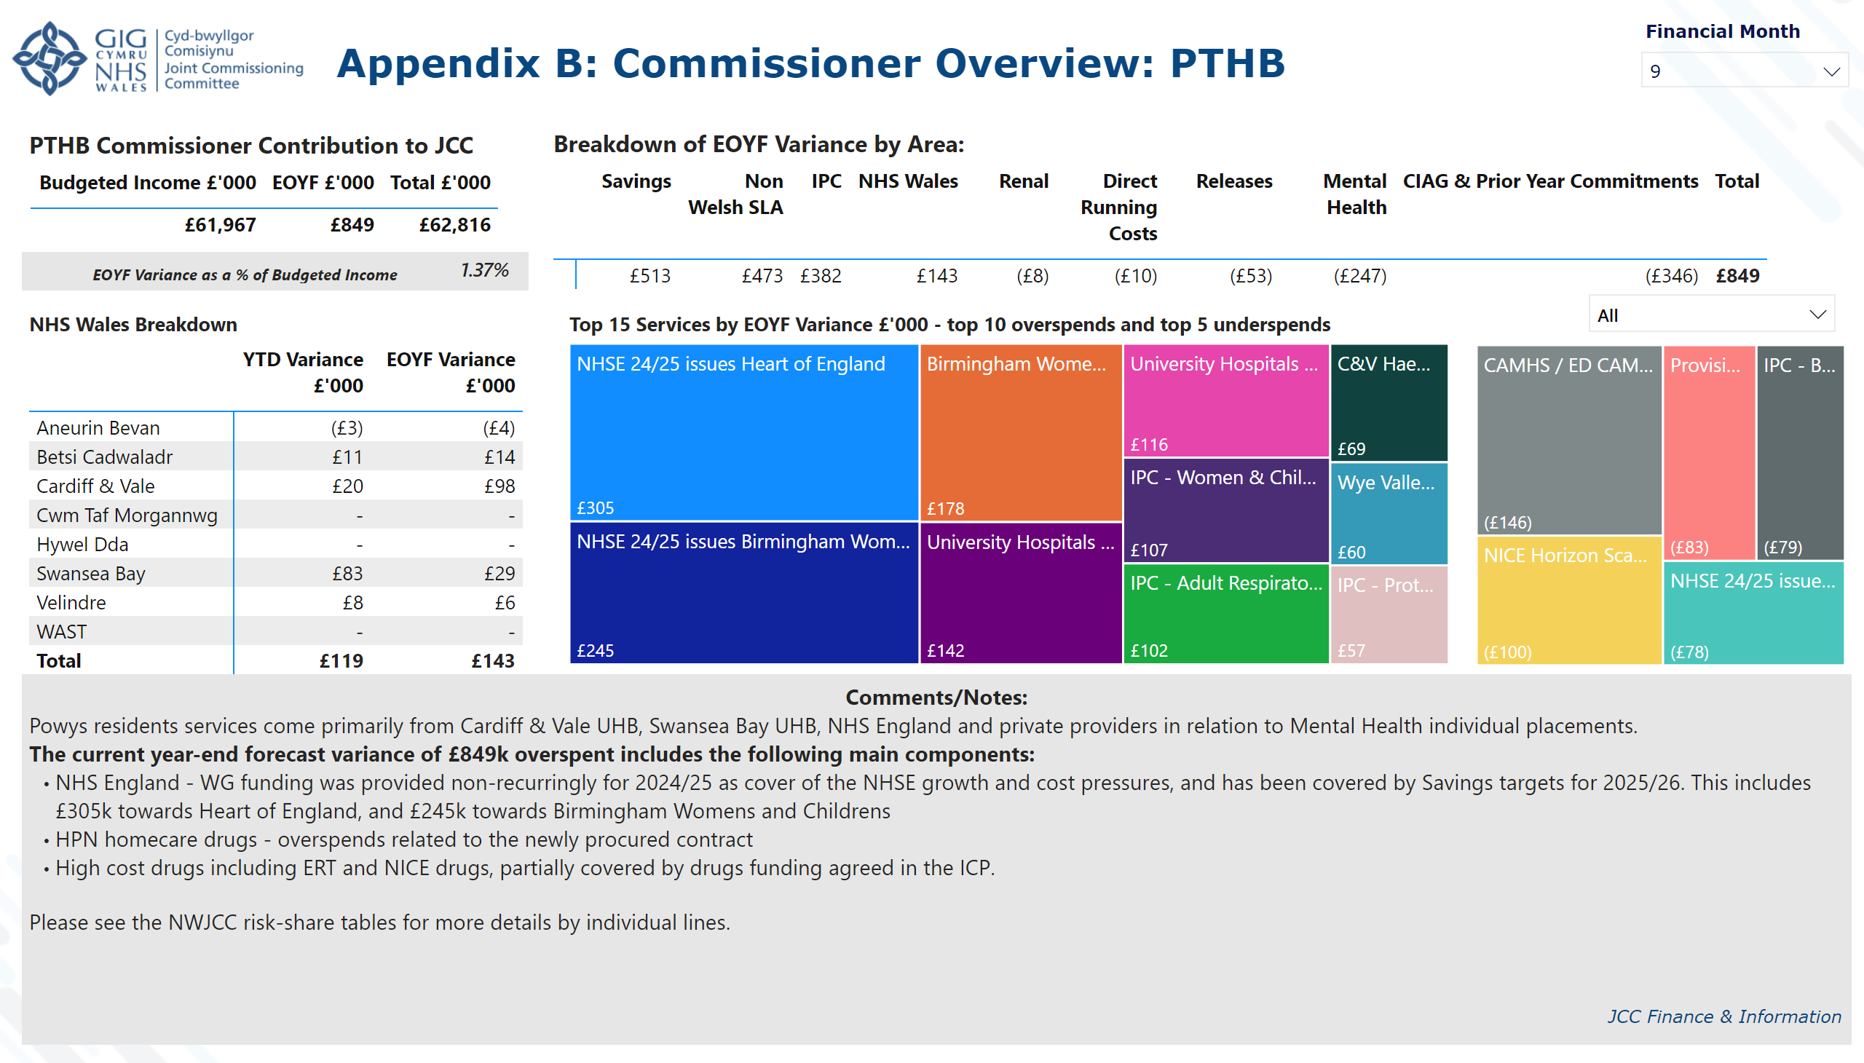
App B. Commissioner: PTHB
Notes:
textbox
No alt text provided
image
No alt text provided
textbox
No alt text provided
slicer
No alt text provided
slicer
No alt text provided
PTHB Commissioner Contribution to JCC
No alt text provided
NHS Wales Breakdown
No alt text provided
Breakdown of EOYF Variance by Area:
No alt text provided
slicer
No alt text provided
card
No alt text provided
textbox
No alt text provided
textbox
No alt text provided
Top 15 Services by EOYF Variance £'000 - top 10 overspends and top 5 underspends
No alt text provided
Top 15 Services by EOYF Variance £'000
No alt text provided
shape
No alt text provided

Slide 20
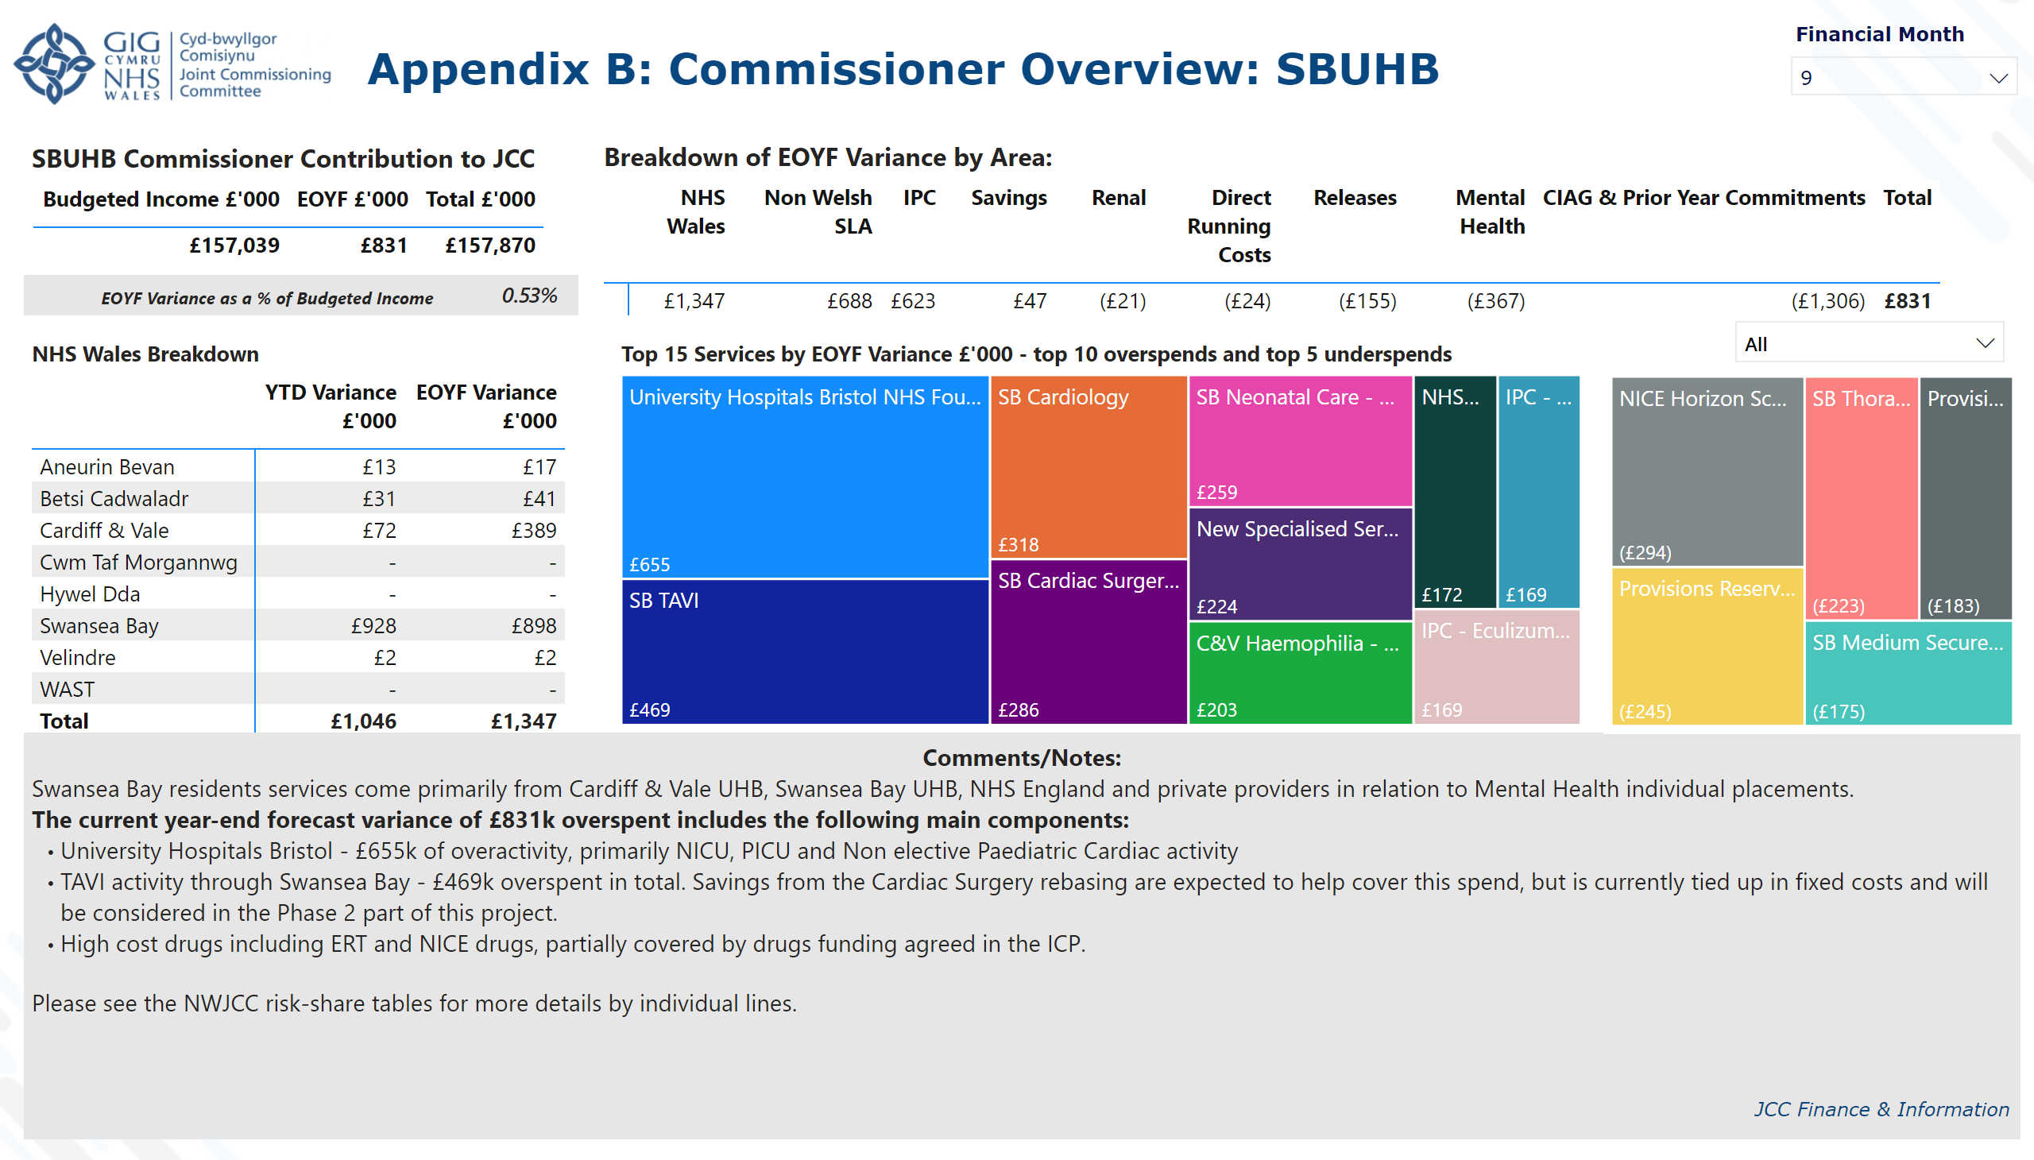
App B. Commissioner: SB
Notes:
textbox
No alt text provided
image
No alt text provided
textbox
No alt text provided
slicer
No alt text provided
slicer
No alt text provided
SBUHB Commissioner Contribution to JCC
No alt text provided
NHS Wales Breakdown
No alt text provided
Breakdown of EOYF Variance by Area:
No alt text provided
slicer
No alt text provided
card
No alt text provided
textbox
No alt text provided
textbox
No alt text provided
Top 15 Services by EOYF Variance £'000 - top 10 overspends and top 5 underspends
No alt text provided
Top 15 Services by EOYF Variance £'000
No alt text provided
shape
No alt text provided

