Slide 1



Quality Report
Management Group
Latest Data loaded March 23
HTTPS://EASC.NHS.WALES
CTM_CASC_EASC@WALES.NHS.UK

Slide 2
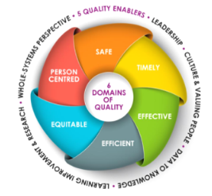
Purpose
The Duty of Quality
The Committee has a responsibility to support the delivery of Emergency Ambulance Services, and therefore must do so with a view to securing improvement in the quality of the services provided.
The Duty of Candour
The Committee has a responsibility to ensure Emergency Ambulance Services are identifying and learning from incidents that have caused harm and supporting the development of initiatives to stop similar incidents from happening again.
The purpose of this report is to ensure both requirements are addressed and to inform the Committee of progress in improving quality of Emergency Ambulance Services.
HTTPS://EASC.NHS.WALES
Quality Report
CTM_CASC_EASC@WALES.NHS.UK

Slide 3
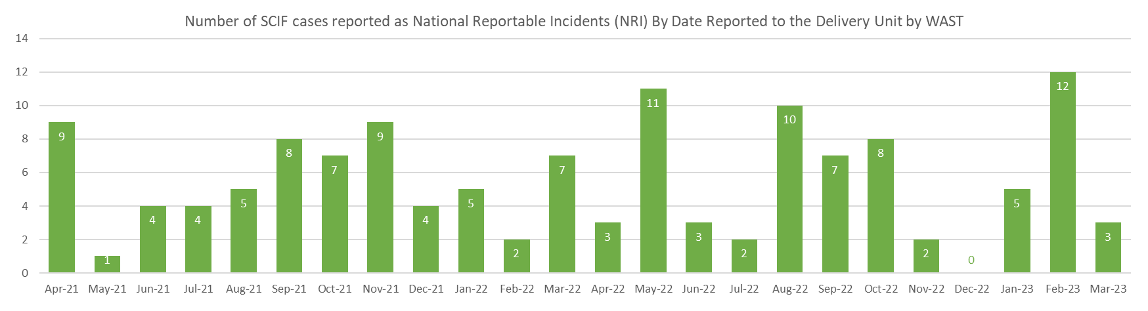
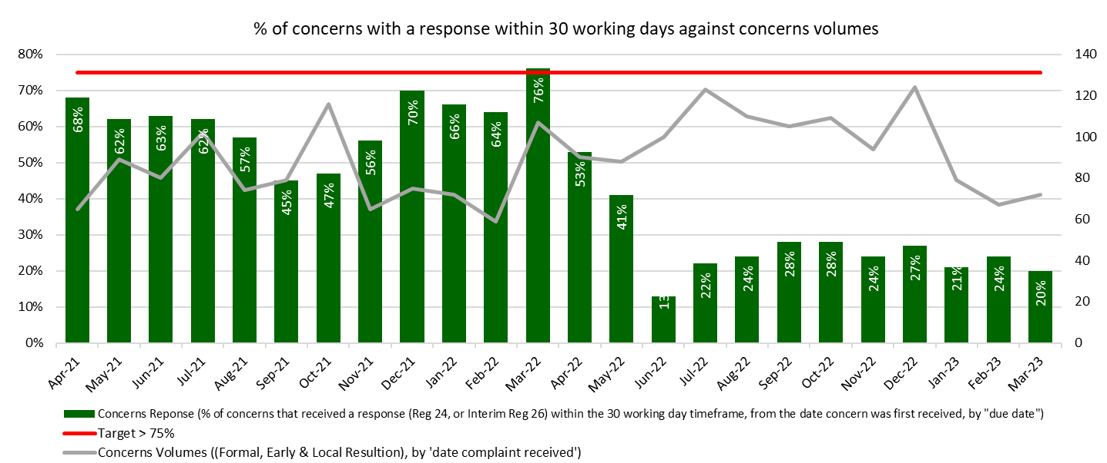
Safe Care
A system level focus on commissioning and ensuring sufficient levels of resource availability to provide safe services.
Recruitment, redeployment and assessment of workload along with an OCP against PTR functions will help mitigate this.
Themes: 'delayed community response' and 'call categorisation'.
Immediate improvement actions
Education of individual staff,
Updates to SOP's,
Circulation of bulletins
HTTPS://EASC.NHS.WALES
Quality Report
CTM_CASC_EASC@WALES.NHS.UK

Slide 4
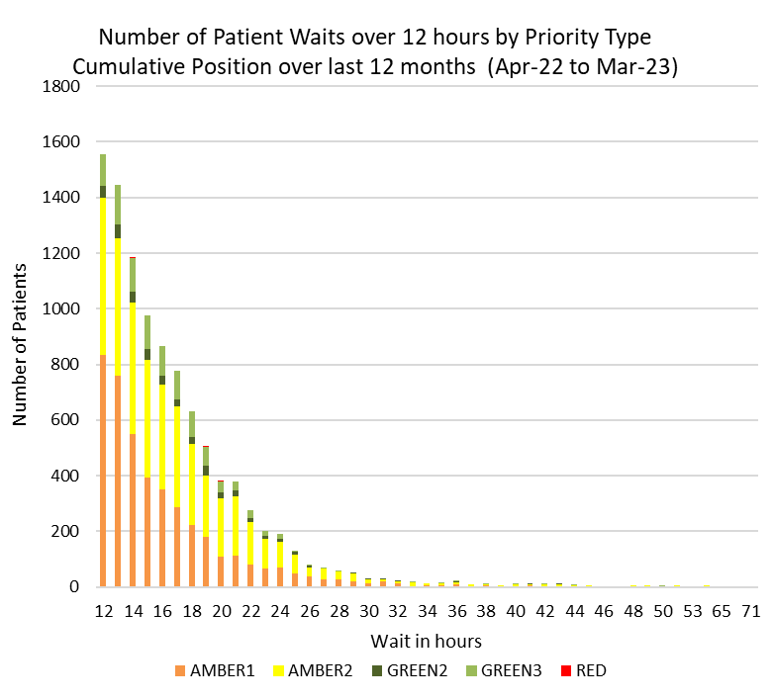
Safe Care
A system level focus on commissioning and ensuring sufficient levels of resource availability to provide safe services.
Joint Investigations
In March WAST identified 15 Joint Investigations and there were 3 referrals from health boards into WAST under the Joint Investigation Framework.
Themes
Delay in raising concern
Lack of clinical input
End of Life Care
End of Life Care planning- feedback to be taken to 6 Goals Steering Group
HTTPS://EASC.NHS.WALES
Quality Report
CTM_CASC_EASC@WALES.NHS.UK

Slide 5




Timely Care
Commissioning services to provide a response within timescales that contribute to improving clinical outcomes and patient satisfaction
Red
The longest wait time for a Red incident in February was 01:41. There were 3,949 incidents categorised as Red. A review of ‘Red’ incidents is underway and due for reporting in May.
In February
Calls Offered: 44,454
Calls Answered: 44,355
847 patients waited over 12 hours for a response which is a significant increase on March (329)
NEPTS
76% of calls were answered within 60 seconds,
4.4% of calls were abandoned before answering.
63.8% of core journeys arrived within 30 minutes of their appointment time.
77% of discharge & transfer patients were collected in less than 60 minutes after their booked ready time.
Amber
The median wait for Amber was 02:47. There were 14,749 incidents categorised as Amber.
Green
The median wait for Green was 03:32 There were 1,336 incidents categorised as Green.
HTTPS://EASC.NHS.WALES
Quality Report
CTM_CASC_EASC@WALES.NHS.UK

Slide 6
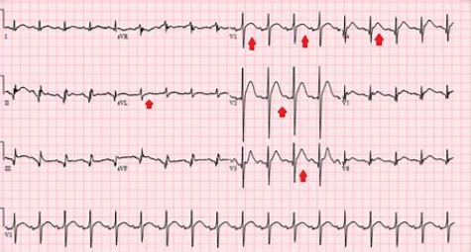
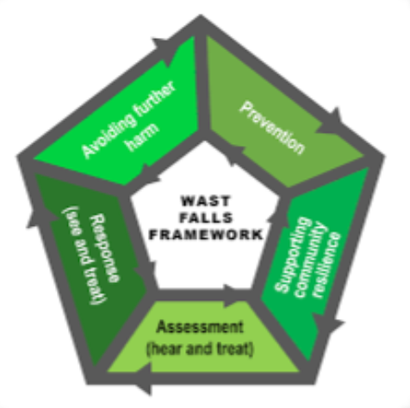
Effective Care
Commissioning services to do deliver care to the right call, at the right time, with the right response.
ST Elevation Myocardial Infarction
Falls- The biggest reason for a 999 call in March
4,271 incidents categorised as a code 17 (Falls).
3,280 of these patients were 75 years or older.
WAST responded to 2,578 incidents (1,153 patients received a falls resource) and conveyed 1,459 patients.
Having been conveyed to hospital, 14% were handed over within 15 mins
The longest time a patient who had been categorised as a code 17 (Falls) waited on an ambulance, outside a hospital, was 26 hours and 50 minutes, however the average time was 2 hours and 20 minutes.
There were a total of 108 patients in March who were documented as having a ST Elevation Myocardia Infarction (STEMI). Of these 38 (35.2%) were documented as receiving appropriate STEMI care bundle.
Return of Spontaneous Circulation (ROSC)
In March
There were 3,949 incidents categorised as 'Red'.
Of these, 307 people had resuscitation attempts started on them,
Of that 43 people arrived at hospital with a return of spontaneous circulation (43/307 = 14% ROSC).
Whilst this report details patients who have fallen and STEMI patients, future reports will explore other clinical outcomes.
HTTPS://EASC.NHS.WALES
Quality Report
CTM_CASC_EASC@WALES.NHS.UK

Slide 7
Efficient Care
65,832 attendances at type 1 ED’s in Wales
Commissioning services to do deliver prudent, value based care
9, 930 patients were brought in by ambulance 15% of total ED demand
61,748 Calls
44,355 Calls
8,668 people were advised by either 111 or 999 to make their own way to ED
20,879 Responded Incidents
6,610
go to ED
1,886 patients were given advice over the phone which resulted in no ED attendance
1,344- told to make own way to ED
714- arranged a Taxi to go to ED
3,630
Ambulance
13,723
Conveyances
111
999
ED’s
HTTPS://EASC.NHS.WALES
Quality Report
CTM_CASC_EASC@WALES.NHS.UK

Slide 8
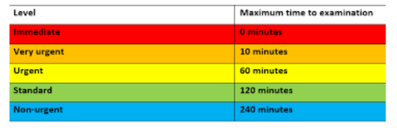
Efficient Care
Commissioning services to do deliver prudent, value based care
Patients who are triaged as Red (or category 1) are considered to be very unwell and are usually patients requiring resuscitation.
What makes a patient a Red / category 1?
Stridor
Airway Compromise
Shock
Inadequate breathing
Unresponsive
Drooling
Currently fitting
Exsanguinating haemorrhage
Chemical eye injury
Unresponsive child
Hypoglycaemia less than 3
Prolapsed umbilical cord
Presenting foetal parts
Acuity of patients arriving at ED
Manchester triage is a clinical risk assessment and management tool which is used to help identify the priority in which patients need to be seen.
In March 263 patients self presented to type 1 ED's that were triaged as a Red/ Category 1. These patients required immediate medical attention and may have benefitted from ambulance intervention.
HTTPS://EASC.NHS.WALES
Quality Report
CTM_CASC_EASC@WALES.NHS.UK

Slide 9
Efficient Care
Commissioning services to do deliver prudent, value based care
The above chart shows the number of patients that self present, that are triaged as category 1.
The chart above shows a slight increase over time in the number of low acuity patients (category 5) that are conveyed by ambulance.
HTTPS://EASC.NHS.WALES
Quality Report
CTM_CASC_EASC@WALES.NHS.UK

Slide 10
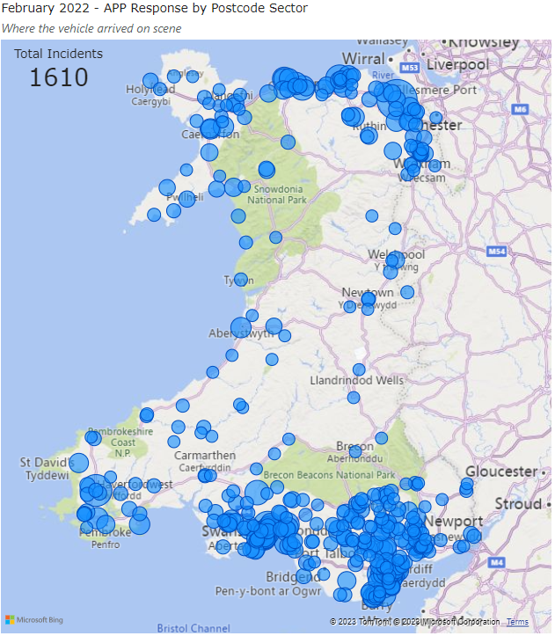
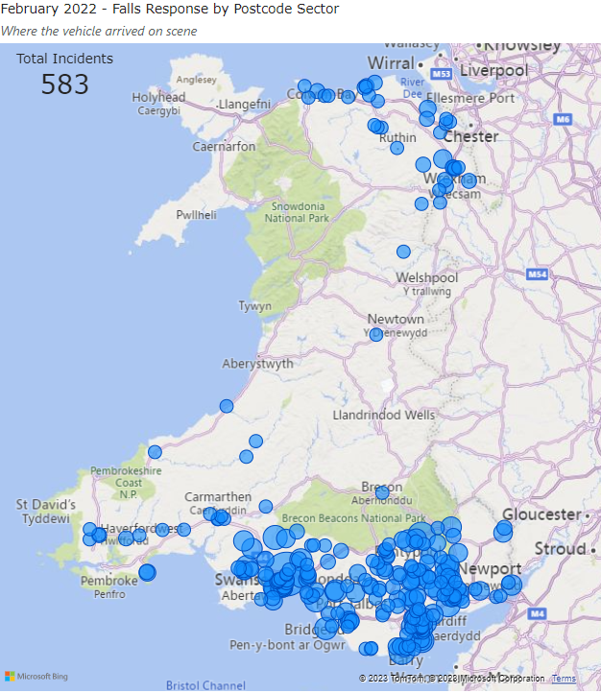
Equitable Care
Commissioning services to provide equity of access and consistency in standards of care to patients across Wales
This map shows the location of where Advanced Practice Paramedics were deployed in March. The data shows resources throughout Wales with the majority of responses in the South.
This map shows the location of where Falls Response Units were deployed in March. The data shows the majority of responses in the South.
Further analysis of benefits and outcomes will be explored
HTTPS://EASC.NHS.WALES
Quality Report
CTM_CASC_EASC@WALES.NHS.UK

Slide 11

Patient Centered Care
Commissioning services to do deliver care that is culturally embedded and supported by a common approach to assessing and managing peoples needs.
Opportunities for learning
Monitoring response to complaint times
Delayed community response – have all opportunities been explored?
Call categorisation – How will this be monitored?
End of Life- How are these patients identified?
Await outcome of review of Red incidents
How do we improve care for older people?
Analysis of patients conveyed by ambulance presenting at ED
Capture patients that were advised to attend ED by another service
Benefits and outcomes for patients that received a specialist response from either an APP or a Falls vehicle.
HTTPS://EASC.NHS.WALES
Quality Report
CTM_CASC_EASC@WALES.NHS.UK

Slide 12
Emergency Ambulance Services Committee
HTTPS://EASC.NHS.WALES
CTM_CASC_EASC@WALES.NHS.UK

