Slide 1



Emergency Ambulance Services Committee
Performance Reporting – Statistical Process Control Charts
Statistical process control (SPC) is an analytical technique that plots data over time. It helps us understand variation and in so doing guides us to take the most appropriate action.
HTTPS://EASC.NHS.WALES
CTM_CASC_EASC@WALES.NHS.UK

Slide 2
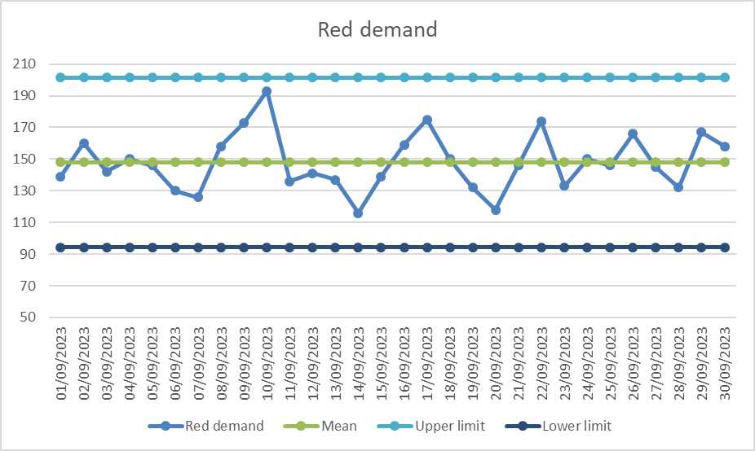
Red Demand
HTTPS://EASC.NHS.WALES
CTM_CASC_EASC@WALES.NHS.UK

Slide 3
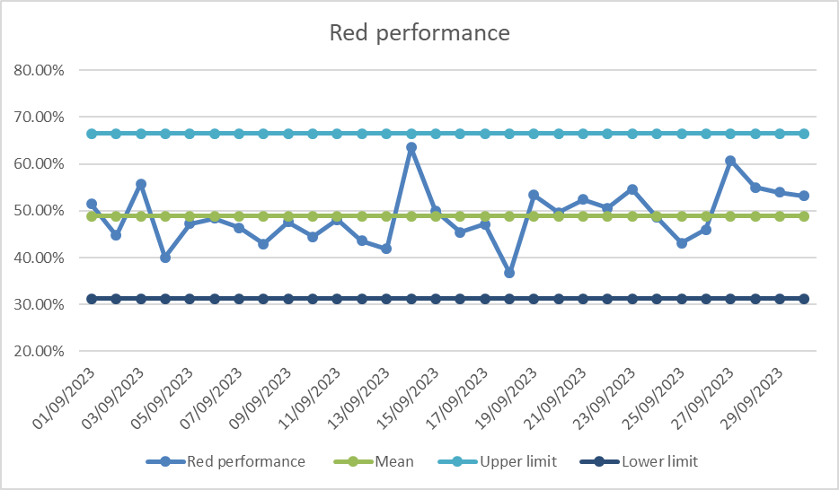
Red Performance
HTTPS://EASC.NHS.WALES
CTM_CASC_EASC@WALES.NHS.UK

Slide 4
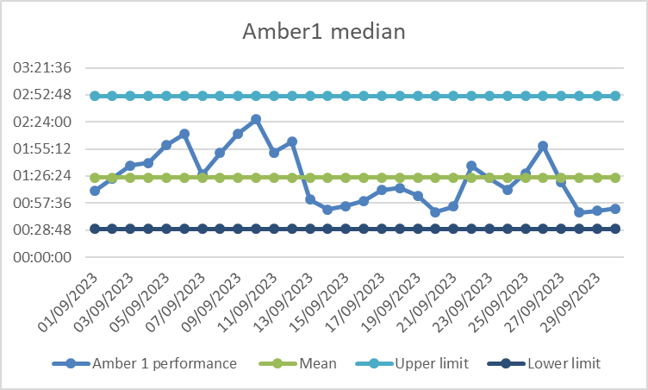
Amber Performance
HTTPS://EASC.NHS.WALES
CTM_CASC_EASC@WALES.NHS.UK

Slide 5
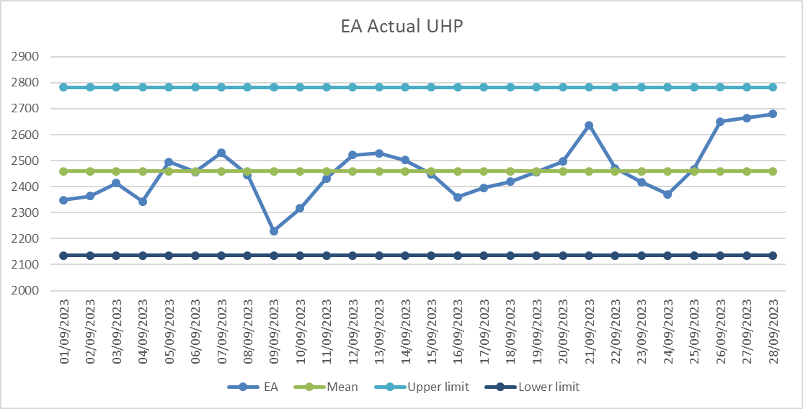
EA Production
HTTPS://EASC.NHS.WALES
CTM_CASC_EASC@WALES.NHS.UK

Slide 6
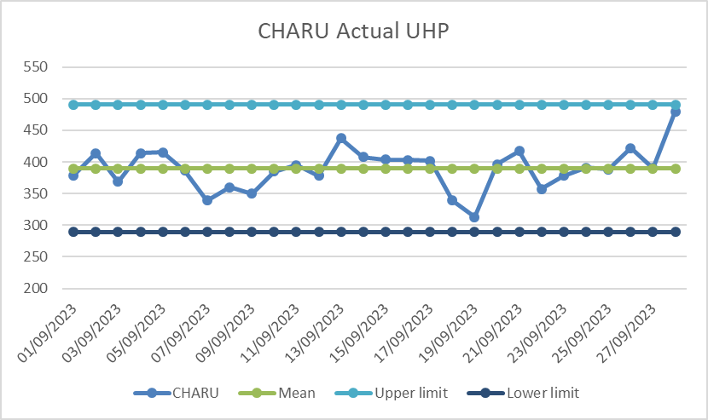
CHARU Production
HTTPS://EASC.NHS.WALES
CTM_CASC_EASC@WALES.NHS.UK

Slide 7
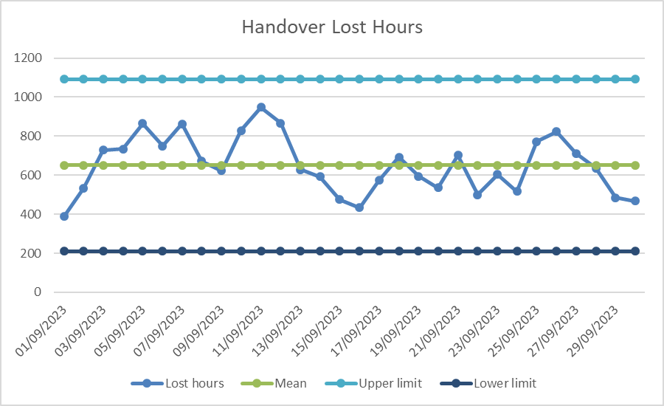
Handover Lost Hours
HTTPS://EASC.NHS.WALES
CTM_CASC_EASC@WALES.NHS.UK

