Slide 1



Emergency Ambulance Services Committee
IMTP Tracker
HTTPS://EASC.NHS.WALES
CTM_CASC_EASC@WALES.NHS.UK

Slide 2
Introduction
  The 2023-26 EASC IMTP set out a number of performance improvement ambitions and performance enablers for Emergency Ambulance Services
  Whilst the EASC IMTP has not yet been formally approved by the Minister for Health and Social Services, the Committee remain committed to the delivery of these improvements.
  This slide deck sets out the progress to date against each of the commitments.
  The Committee agreed to review these commitments during the year in light of system progress, this presentation suggest a number of areas for review during Q1 as a result of early delivery of ambitions.
HTTPS://EASC.NHS.WALES
EASC IMTP 23/26 Tracker
CTM_CASC_EASC@WALES.NHS.UK

Slide 3
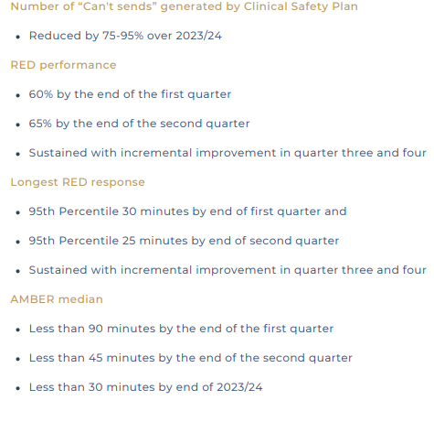
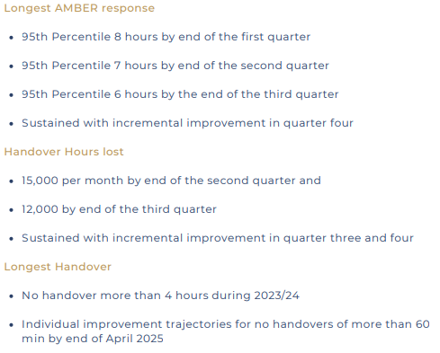
Summary – Performance Improvement
HTTPS://EASC.NHS.WALES
EASC IMTP 23/26 Tracker
CTM_CASC_EASC@WALES.NHS.UK

Slide 4
“Cant Sends” - Reduced by 75-95% over 2023/24
*CSP Can’t sends only
HTTPS://EASC.NHS.WALES
EASC IMTP 23/26 Tracker
CTM_CASC_EASC@WALES.NHS.UK

Slide 5
Red Performance – 60% by end of Q1
Requirement to achieve 65% by end of Q2
HTTPS://EASC.NHS.WALES
EASC IMTP 23/26 Tracker
CTM_CASC_EASC@WALES.NHS.UK

Slide 6
Longest Red – 95th Percentile 30 min by end of Q1
In July 2023 EASC agreed to update their Q2 ambition– to be less than 18 min
Sustained incremental improvement in Q3/4
HTTPS://EASC.NHS.WALES
EASC IMTP 23/26 Tracker
CTM_CASC_EASC@WALES.NHS.UK

Slide 7
Amber Median - < 90 min by end of Q1
Requirement to achieve 45 min by end of Q2
Less than 30 min required by end of 2023/24
HTTPS://EASC.NHS.WALES
EASC IMTP 23/26 Tracker
CTM_CASC_EASC@WALES.NHS.UK

Slide 8
Longest Amber – 95th Percentile 8 hours by end Q1
At the July 2023 meeting EASC agreed to revise the improvement ambitions to Quarter 2 less than 4.5 hours and Quarter 3 less than 3.5 hours.
Sustained incremental improvement by in Q4
HTTPS://EASC.NHS.WALES
EASC IMTP 23/26 Tracker
CTM_CASC_EASC@WALES.NHS.UK

Slide 9
Handover Hours – 15,000 Lost per month by end of Q2
Requirement to achieve 12,000 hours per month by end of Q3
Sustained and incremental improvement in Q4
HTTPS://EASC.NHS.WALES
EASC IMTP 23/26 Tracker
CTM_CASC_EASC@WALES.NHS.UK

Slide 10
Longest Handover – No Handover >4 Hours in 2023/24
Requirement for all sites to eradicate waits over 1 hour by end of April 2025
HTTPS://EASC.NHS.WALES
EASC IMTP 23/26 Tracker
CTM_CASC_EASC@WALES.NHS.UK

Slide 11
Longest Handover – No Handover >1 Hours by April 2025
Requirement for all sites to eradicate waits over 1 hour by end of April 2025
WG requested HB forecast to end of March 2024.
HTTPS://EASC.NHS.WALES
EASC IMTP 23/26 Tracker
CTM_CASC_EASC@WALES.NHS.UK

Slide 12
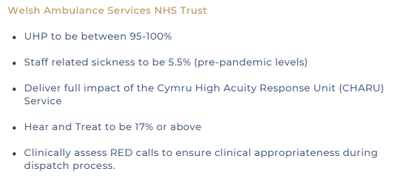
Summary – Performance Enablers – WAST
HTTPS://EASC.NHS.WALES
EASC IMTP 23/26 Tracker
CTM_CASC_EASC@WALES.NHS.UK

Slide 13
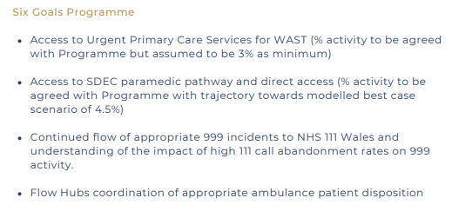
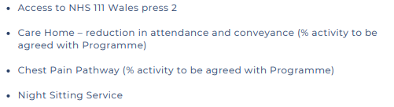
Summary – Performance Enablers – Six Goals
HTTPS://EASC.NHS.WALES
EASC IMTP 23/26 Tracker
CTM_CASC_EASC@WALES.NHS.UK

Slide 14
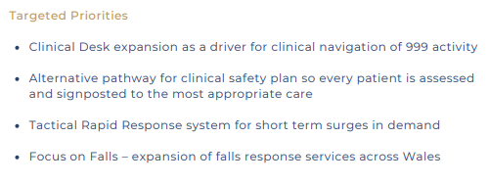
Summary – Performance Enablers – Targeted
HTTPS://EASC.NHS.WALES
EASC IMTP 23/26 Tracker
CTM_CASC_EASC@WALES.NHS.UK

