Slide 1



EMRTS Service Development Review 2023
Phase 1 - Engage (You are telling us…)
Gathering of feedback on factors, weightings, and other suggestions to inform options to be developed
(Full report at Agenda item 2.5)
What we heard...

Slide 2


EMRTS Service Development Review 2023 – Phase 1
Factors for developing options for EMRTS
EASC have used the following reasons before but want to know if you agree with these factors as a way to help decide what to do next:
Health Gain
EMRTS should be as efficient and effective as possible and as many people as possible should get a service
Equity
Everyone in Wales should have fair / same (equitable) access to the service to benefit from its outcomes
Clinical Skills and Sustainability
It is very important that we look after the staff and make sure there is good training available for staff to make the best use of their advanced skills
As a minimum, we should spend the same as we do now
Value for Money
Affordability
If we want to develop services, we must make sure they provide value for money
An effective road response is important especially when the helicopters can’t fly and to provide improved cover during the hours of darkness.
We should have more aircraft able to land wherever needed when it is dark.
Before any change happens, there must be a plan for EMRTS to be able to carry on as now
Emergency Ambulance Services Committee

Slide 3
EMRTS Service Development Review 2023 – Phase 1
Which of these 5 factors are the most important?
Factor | Weighting
Health Gain | 25
Equity | 25
Value for Money | 20
Clinical Skills and Sustainability | 15
Affordability | 15
Total | 100
Emergency Ambulance Services Committee

Slide 4

EMRTS Service Development Review 2023 – Phase 1
What we heard…
A – Emerging Themes
EMRTS Service Review
B – Emerging Themes
Broader Health & Care System
Emergency Ambulance Services Committee

Slide 5


EMRTS Service Development Review 2023 – Phase 1
What we heard…
A – The Review …about EMRTS
Support & Appreciation
‘Fast ambulance’
Local bases/local service
Hours of operation
Initial Service Development Proposal
Both air and road response
Staffing impact implications
Mutual aid operations
Understanding of the problem to fix
Effectiveness of working with other services/agencies
Emergency Ambulance Services Committee

Slide 6


EMRTS Service Development Review 2023 – Phase 1
What we heard…
A – The Review …about the initial Service Development Proposal
Another rural ‘loss’
Increased risk of 2 assets on 1 base
Understanding of unmet need
Coastal locations coverage
Rapid response vehicle RRV response
Original base location rationales
Crews needing to treat patients
Weather affecting operations
Emergency Ambulance Services Committee

Slide 7
EMRTS Service Development Review 2023 – Phase 1
What we heard…
A – The Review …about the Charity
Funding risk
Reputational damage
Cost-saving perception
Accepting recommendation
Emergency Ambulance Services Committee

Slide 8
EMRTS Service Development Review 2023 – Phase 1
What we heard…
A – The Review …about specific rural and coastal challenges
Remote and lone working
Road infrastructure
Seasonal population variations
High risk activities
Geography and topography
Climate change affecting access
Mobile phone coverage
Patient road transfer experience and outcomes
Emergency Ambulance Services Committee

Slide 9
EMRTS Service Development Review 2023 – Phase 1
What we heard…
A – The Review …about rural versus urban areas
Public services ‘prioritised in urban’
Use of service per head of population
Different needs in rural and urban areas
Emergency Ambulance Services Committee

Slide 10

EMRTS Service Development Review 2023 – Phase 1
What we heard…
A – The Review …about response times
Increased times
‘Golden hour’ loss
Proximity to minor injury units/Emergency departments/Trauma Units
Adverse weather impact
RRV capabilities
Emergency Ambulance Services Committee

Slide 11
EMRTS Service Development Review 2023 – Phase 1
What we heard…
A – The Review …about data
Initial data detail
Historical and forecasting data
Patient related outcome measures (PROMs) not just attendances
Change impact data for rural
Average response times for rural not for Wales
Wider timeframe reference
Seasonal and population variation to be included
Projected demographics for rural areas
Climate change impacts
Future HB strategic developments and learning from the past
Sharing data
Not just data but people
Explaining underutilisation data
Emergency Ambulance Services Committee

Slide 12
EMRTS Service Development Review 2023 – Phase 1
What we heard…
A – The Review …about factors and weightings
Clinical Skills & Sustainability >15
Value for Money <20
Definition detail
Cost-saving perception
Crossover between factors
Emergency Ambulance Services Committee

Slide 13
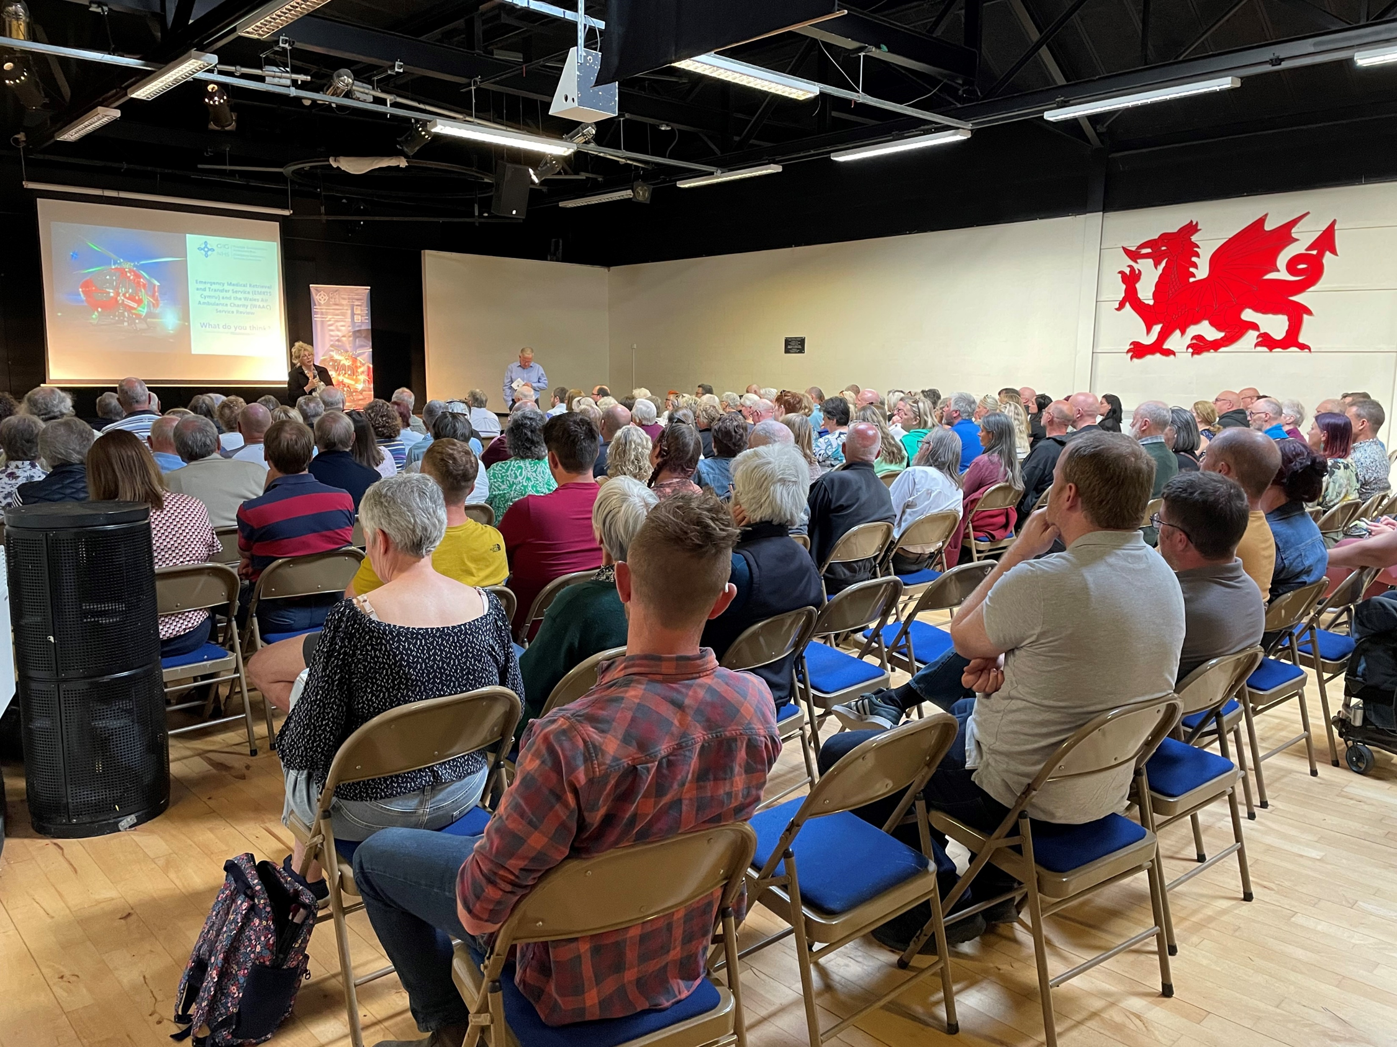
EMRTS Service Development Review 2023 – Phase 1
What we heard…
A – The Review …about engaging
Complexity
Questionnaire
Lead-in times
Access to digital
Scope of stakeholders
Increased communication
Trust and confidence in Commissioner and process
Not a ‘fait accompli’
‘balanced, fair, comprehensive and diligent’
Emergency Ambulance Services Committee

Slide 14
EMRTS Service Development Review 2023 – Phase 1
What we heard…
A – The Review …suggestions
Same bases, different hours
Same bases, additional RRV for N Wales
All bases 24/7
Base investment
2 air assets in Welshpool
Welshpool 24/7 instead of Cardiff
Welshpool 24/7 in addition to Cardiff
Caernarfon 24/7 in addition to Cardiff
More RRVs in Welshpool
Move South Wales bases
All 4 bases into 1
Specialist service versus traditional ambulance response
Ambulance provide similar critical care skills
Incremental changes from aviation contract
Fire and Rescue opportunities
Emergency Ambulance Services Committee

Slide 15
EMRTS Service Development Review 2023 – Phase 1
What we heard…
A – Emerging Themes
EMRTS Service Review
B – Emerging Themes
Broader Health & Care System
Emergency Ambulance Services Committee

Slide 16
EMRTS Service Development Review 2023 – Phase 1
What we heard…
B – Broader System …about the Health and Care System
Support
Appreciation of scale
Landscape
Vulnerability
Context of other services
Emergency Ambulance Services Committee

Slide 17

EMRTS Service Development Review 2023 – Phase 1
What we heard…
B – Broader System …about Welsh Ambulance Service
Out of areas
Recruitment
999 triaging
Handover delays
Emergency Ambulance Services Committee

Slide 18
EMRTS Service Development Review 2023 – Phase 1
What we heard…
B – Broader System …about Primary and Secondary Care
Access to services
Citizen involvement
Local service loss
Sustainability of services
Emergency Ambulance Services Committee

Slide 19
EMRTS Service Development Review 2023 – Phase 1
What we heard…
B – Broader System …about Health and Social Care & Public Services
Integration
Citizen involvement
Local service loss
Education and awareness campaigns
Emergency Ambulance Services Committee

Slide 20
EMRTS Service Development Review 2023 – Phase 1
What we heard…
B – Broader System …about Policy and Decision Makers
Current pressures
Citizen involvement
Reliance on charitable donations
Road infrastructure policy
Emergency Ambulance Services Committee

