Slide 1




A Modernised Ambulance Service for the Future
Rachel Marsh, Director of Strategy,
Planning and Performance
Welsh Ambulance Services NHS Trust

Slide 2

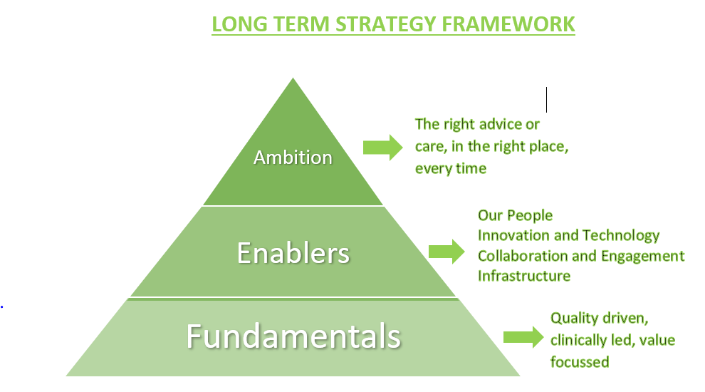

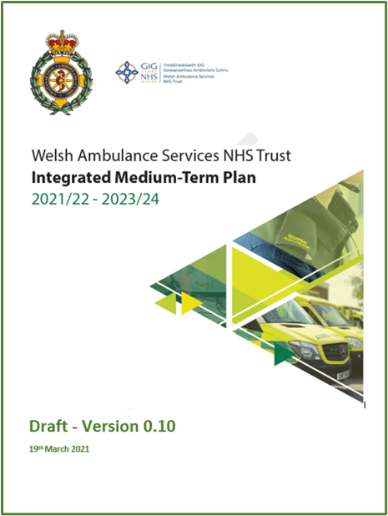



Building on our Long Term Strategy Framework
www.ambulance.wales.nhs.uk @welshambulance welshambulanceservice
Notes:
Our Long Term strategy has been in place for a couple of years, sets out some very high level ambitions
Our work now is seeking to turn this strategic framework into a more meaningful description of how our services could be transformed to deliver improvements in service to our patient but also to play a wider part in the unscheduled care system

Slide 3
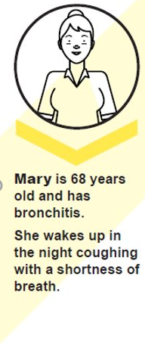
A patient perspective - current
I woke up coughing and short of breath.
I phoned 999.
The paramedics were nice.
They did some tests and calmed me down but thought I needed to go to hospital.
I waited a long time outside A&E and, in the end, I had to stay in.
Unfortunately, I got another infection and stayed in hospital for a week.
www.ambulance.wales.nhs.uk @welshambulance welshambulanceservice

Slide 4
A patient perspective - future
I rang 111 and a nurse spoke to me and assessed me via video. I was able to give him some information about my heart rate and temperature because my smart watch measures this. After he read some of my medical history the nurse arranged for an advanced paramedic to visit me that same day. The advanced paramedic was lovely and was able to prescribe me some antibiotics and I was able to stay at home.
www.ambulance.wales.nhs.uk @welshambulance welshambulanceservice

Slide 5
Where are we now?
Very efficient 999 call handling service, but many callers do not have life threatening or emergency needs
www.ambulance.wales.nhs.uk @welshambulance welshambulanceservice
Notes:
Poor patient experience, likely to be poorer outcomes and increased system pressure at EDs

Slide 6
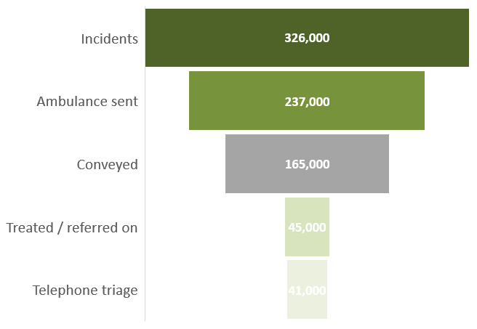
Where are we now?
Expensive ambulance resource dispatched to too many 999 calls and too many conveyances to a major ED, when the patient’s needs could be met more appropriately in other ways, closer to home
Around 20% of calls receive a clinical assessment
29% amber conveyances discharged from ED with no follow up
www.ambulance.wales.nhs.uk @welshambulance welshambulanceservice
Notes:
Poor patient experience, likely to be poorer outcomes and increased system pressure at EDs

Slide 7
Where are we now?
An expanding 111 service, but public remains unclear about where to turn if they have an urgent care need
Opportunities for improved pathways
www.ambulance.wales.nhs.uk @welshambulance welshambulanceservice

Slide 8
Where are we now?
A front end 111 website that is visited millions of times per year, but with the majority of users reporting difficulty in finding the information they need
Scarce clinical resources for remote clinical triage and assessment are fragmented into lots of small pockets across many organisations
Different providers across the system do not communicate as well as they should in developing clear pathways for patients which often results in poor patient experience and outcomes across handoff points
Ultimately, patients do not get access to the right service to best meet their needs, have a poor experience and bottlenecks are created at the front end of the system as A&E remains default.
www.ambulance.wales.nhs.uk @welshambulance welshambulanceservice

Slide 9
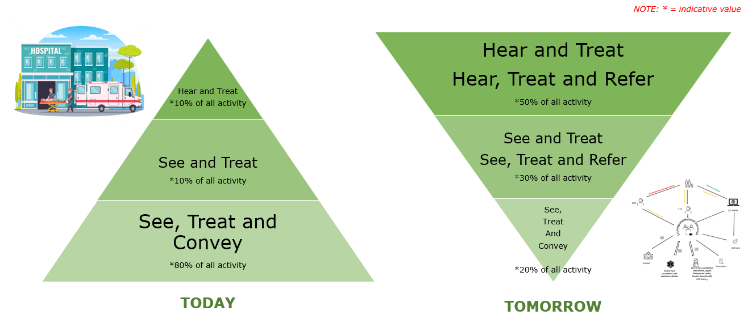
Future ambition
www.ambulance.wales.nhs.uk @welshambulance welshambulanceservice

Slide 10
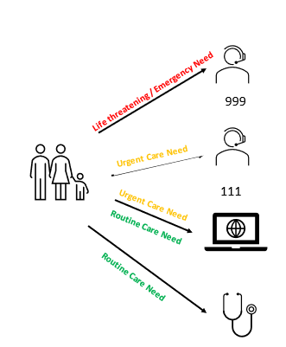
Key Components of the new system:
A simplified access system
We will develop a simplified system for people across Wales when they have a health care need:
Ring 999 for patients with an immediately life threatening or emergency care need
111 ‘Gateway to Care’ service (digital or telephone) for patients with an urgent health care need (care needed the same day)
Contact Local GP for patients who have health care needs that are not urgent and can be scheduled
www.ambulance.wales.nhs.uk @welshambulance welshambulanceservice

Slide 11
Key Components of the new system:
Meeting Life Threatening and Emergency Care Needs
Our 999 service will provide patients with the highest quality of care…
calls are answered immediately
where required, an ambulance is dispatched straight away, wherever the patient is in Wales
crews have the right skills, equipment and information to assess and treat patients safely
where patients can safely be treated closer to home, patients are referred to the right service to meet their needs, seamlessly
where appropriate, patients are taken to the hospital that best meets their needs and handed over to them quickly
if patients ring 999 and don’t have an emergency or life threatening need, the 111 teams pick up their call, assess them and find them the right service
www.ambulance.wales.nhs.uk @welshambulance welshambulanceservice

Slide 12



Key Components of the new system:
Life Threatening and Emergency Care Needs
What will need to be different to enable this to happen?
 | Capacity matched to demand across Wales to provide quicker response | Different models in rural communities Increased numbers of front line staff (increasing time on scene) Improved efficiency (abstractions, post production losses, handover)
 | Clinicians attending scene better equipped to assess, treat, refer | Access to relevant patient information (GP / Hospital) Consistent access to remote advice (GPs, consultant connect, WAST clinical desk) On scene diagnostics
 | Consistent referral pathways in place across Wales for on-scene staff | Many more seamless pathways in place for referral into alternative services closer to home Alternative routes agreed into hospital (i.e. other than ED) Handover delays eradicated
111 | More callers have clinical assessment before response agreed | Increased numbers and range of clinicians available in 999 / 111 Improved clinical assessment tools (e.g. LOWCODE, SALUS) More autonomous practitioners
www.ambulance.wales.nhs.uk @welshambulance welshambulanceservice

Slide 13
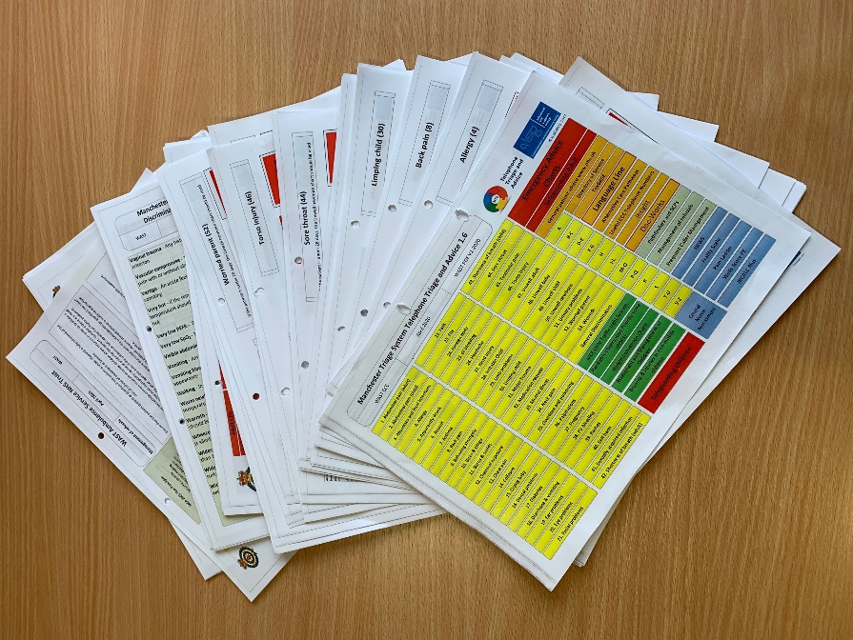
Key Components of the new system:
Remote Clinical Assessment for 999 callers
Existing triage system not fit for purpose
52 basic paper/pdf triage cards
Poor clinical support & confidence
Poor evidence base
Non standard approach to triage
No integration with any system
No data
No digital audit system
Repetition / wasted time
www.ambulance.wales.nhs.uk @welshambulance welshambulanceservice

Slide 14
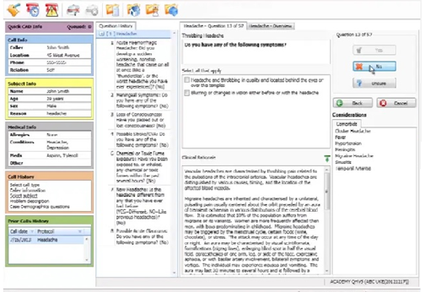
Key Components of the new system:
Remote Clinical Assessment for 999 callers
Proposed new solution - Lowcode
Designed for 999 acuity
Designed for clinicians
Over 250 clinical algorithms
Significant evidence base
More support to triage more patients (Children, pharmacology, medical, minor injuries)
More appropriate referrals
Wider system benefits & confidence
Integrated Doss, video, WCP, C3, MPDS, ePcr
Integrated clinical audit system
E-referrals to other providers
www.ambulance.wales.nhs.uk @welshambulance welshambulanceservice

Slide 15
Key Components of the new system:
Remote Clinical Assessment for 999 callers
Benefits…….
Reduce the number of ambulances being sent to patients through ‘hear and treat’.
Reduce the number of patients attending an Emergency Department by making the contact with a WAST CSD Clinician the point of definitive care and by increasing the use of alternative care pathways.
Increase ambulance availability to respond to the most acutely unwell patients in the Red and Amber categories
Improved safety of long waiting patients through the creation of additional capacity to safety net those patients and provide more robust advice.
Every 0.5% H&T achieved annually equates to 10 WTE front line ambulance staff saved; equivalent to ne emergency ambulance 24/7 for a whole year.
www.ambulance.wales.nhs.uk @welshambulance welshambulanceservice

Slide 16


Key Components of the new system
‘Gateway to Care’
111 - the ‘Gateway to Care’ for urgent physical and mental health needs
Information, advice and signposting available on a wide range of online media
Increasingly personalised advice and interaction available online
Calls to 111 answered quickly by skilled call handlers
Where appropriate, calls passed to the integrated national
clinical hub for a clinical assessment by a clinician or specialist
with the right skills, experience and information.
Depending on need, patients may be given self-care advice, offered a prescription, booked into a face-to-face appointment(e.g. ambulance clinician, GPOOH, community service) or booked into an appointment at hospital.
If they need to go to hospital, and depending on their needs, patients may make their own way there or transport arranged.
www.ambulance.wales.nhs.uk @welshambulance welshambulanceservice

Slide 17
Key Components of the new system
‘Gateway to Care’
Patient and system outcomes…….
Patients & service users with urgent physical or mental health needs are clear about where they need to go
People are provided with information and advice that allows them to manage their own care
If they cannot self care, they are seamlessly transferred to the right service, in the right place, every time, and in as few steps as possible
Provides tailored care based on need, closer to home
A visit to hospital is planned only when it is essential
Seamless, equitable advice & care tailored to local settings across Wales
www.ambulance.wales.nhs.uk @welshambulance welshambulanceservice

Slide 18


Key Components of the new system:
‘Gateway to Care’
What will need to be different to enable this to happen? | Deliverables. We will……
 | 111 is promoted actively as the port of call for urgent health needs | Full role out of core 111 Contact First Mental Health Helplines Appropriate levels of access 24/7 Wearables
 | Accessibility, content and user experience of 111 Digital improved | Improved layout / useability Increased number of social media platforms Increased and improved symptom checkers Increasingly personalised advice Chat bots Seamless referral to clinical assessment / face to face care Artificial intelligence
www.ambulance.wales.nhs.uk @welshambulance welshambulanceservice

Slide 19

Key Components of the new system:
‘Gateway to Care’
What will need to be different to enable this to happen? | Deliverables. We will……
 | Capacity and capability of the integrated clinical teams increased | Increased number and range of clinicians and specialists in a once-for-Wales national service Immediate access to local secondary or more specialist assessment in health boards Increased level of autonomy of practitioners, trusted assessors Increasingly bring together 111 and 999 clinical teams Ability to engage via telephone or video
 | Number of seamless pathways from the clinical team to appropriate face to face consultations increased | National Directory of Service populated and up to date with many more local seamless pathways Ambulance practitioners provide face to face assessment Increased level of ability to book into onward services Reduction in duplicate assessments / multiple handoffs
www.ambulance.wales.nhs.uk @welshambulance welshambulanceservice

Slide 20
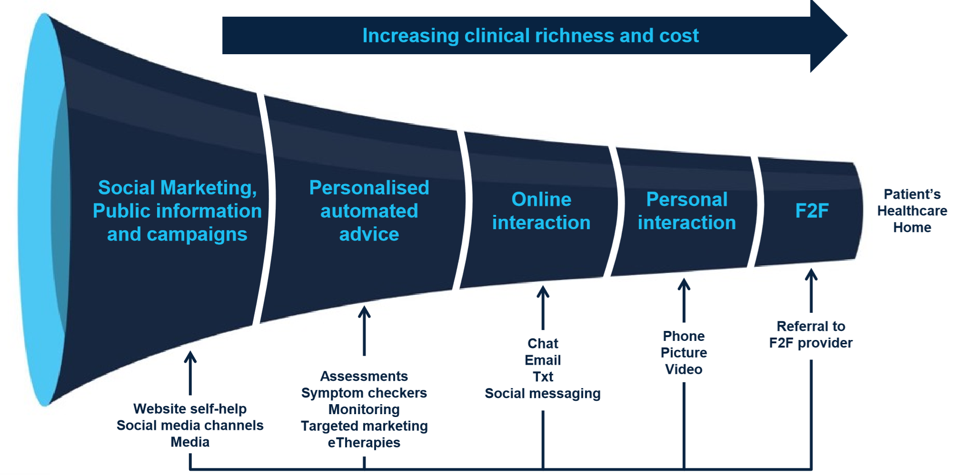
Model of care
www.ambulance.wales.nhs.uk @welshambulance welshambulanceservice

Slide 21
Benefits to patients, colleagues and the system
People
System
Improved health and wellbeing
Parity of physical and mental health from the outset of care intervention
Public better informed on choices available / self care
Quality and accessible services
Equal outcomes for all patients across Wales
Patients get the right service, in the right place, in a timely way
More patients able to be treated safely closer to home
Improved health and wellbeing
Increased utilisation of community based services / pathways
Seamless integration of health and care services bring wider benefits
Quality and accessible services
Reduced pressure on EDs and hospital systems
Driving improvement / compliance against commissioning intentions
Higher value
Co-production of service models deliver outcomes that matter to patients
Motivated and sustainable workforce
Increased opportunities for skill and career development
Opportunities for working across professional and organisational boundaries
Higher value
Reduction in inappropriate ED conveyances and associated avoided bed day costs
Reduction in ambulance journeys
Best Practice Models applied consistently across NHS Wales
Motivated and sustainable workforce
Enhanced workforce collaboration and co-production of services leads to more sustainable workforce
www.ambulance.wales.nhs.uk @welshambulance welshambulanceservice

Slide 22
Core Principles as we design a new future…..
What core principles might we agree?
Consistent levels of access and outcomes for people across Wales
Evidence-based services that provide high quality care
Co-production of service models with patients, clinicians and stakeholders
Services that provide value: reduced duplication and variation, maximising use of scarce resources with national or regional services closely tied to local offers
Joined-up commissioning, managed across provider boundaries, reducing steps in pathways where possible, but maximising safety and governance where they are essential
www.ambulance.wales.nhs.uk @welshambulance welshambulanceservice

Slide 23
Questions / Next Steps
Do these offers for a modernised ambulance service align with and complement WG / Health Board strategies and plans?
What is the governance route for ongoing development of this strategy for the system?
What are the implications for the workforce across the system? Engage with HEIW for support
  Remote clinical assessment as an emerging speciality
  Closer working across provider boundaries – trusted assessors / rotational posts / secondments
  Changing skill mix and range of professions across the system
What are the implications in relation to technology? Engage with Digital Wales
www.ambulance.wales.nhs.uk @welshambulance welshambulanceservice

