Slide 1




EASC
Focus on NEPTS
10 May 2022
Welsh Ambulance Services NHS Trust

Slide 2

Focus On NEPTS - Executive Summary
Daily patient volumes (pre-CoVID-19) were more than double EMS, but with significantly less transport hours. Patient volumes have not quite recovered to pre-CoVID-19 levels, but capacity has been reduced as a result of social distancing.
WAST operates a plurality model using a mix of in-house provision and procured third party transport pan-Wales.
WAST has expert knowledge of providing and procuring non-emergency patient transport.
Third party providers are quality assured using a WAST QA framework, similar to CQC.
NEPTS is critical to patient flow, in particular, the discharge and transfer service.
WAST has access to powerful transport simulation software which can model transport requirements and has recently undertaken a strategic demand & capacity review for NEPTS.
A lesson from the GUH experience is engage early with WAST, use the software available and reach timely agreement on the transport model.
NEPTS has a historic overspend that needs to be addressed through demand and capacity management. EASC decisions and support are required here.
EASC commissioning intentions focus on driving value out of the plurality model, demand management (re-rostering), increasing capacity (efficiencies and utilisation) and further developing its approach to forecasting & modelling. WAST has a substantial transformation programme for Ambulance Care (NEPTS) linked to its IMTP and the commissioning intentions.
Current areas of performance focus are call answering, oncology and eligibility criteria. Oncology may require a change in performance standard.
Welsh Ambulance Services NHS Trust

Slide 3
It’s not like EMS (Emergency Medical Services)
There are many significant differences between NEPTs and EMS across Wales:
Daily patient volumes are significantly higher (c 3000 per weekday compared to c. 1000 in EMS).
Resource levels are lower than EMS (c 1,500 vehicle hours per day compared to c. 3,500 in EMS)
Patients have differing mobility requirements and multiple patients can be loaded onto one vehicle
There are multiple providers of NEPTs transport, not just WAST
Outpatient journeys are booked in advanced; however, patients are often not ready at their collection time from clinics which is a key inefficiency.
The majority of discharge and transfer journeys are booked on the day which indicates a lack of forward discharge planning and is also a key inefficiency.
Welsh Ambulance Services NHS Trust

Slide 4
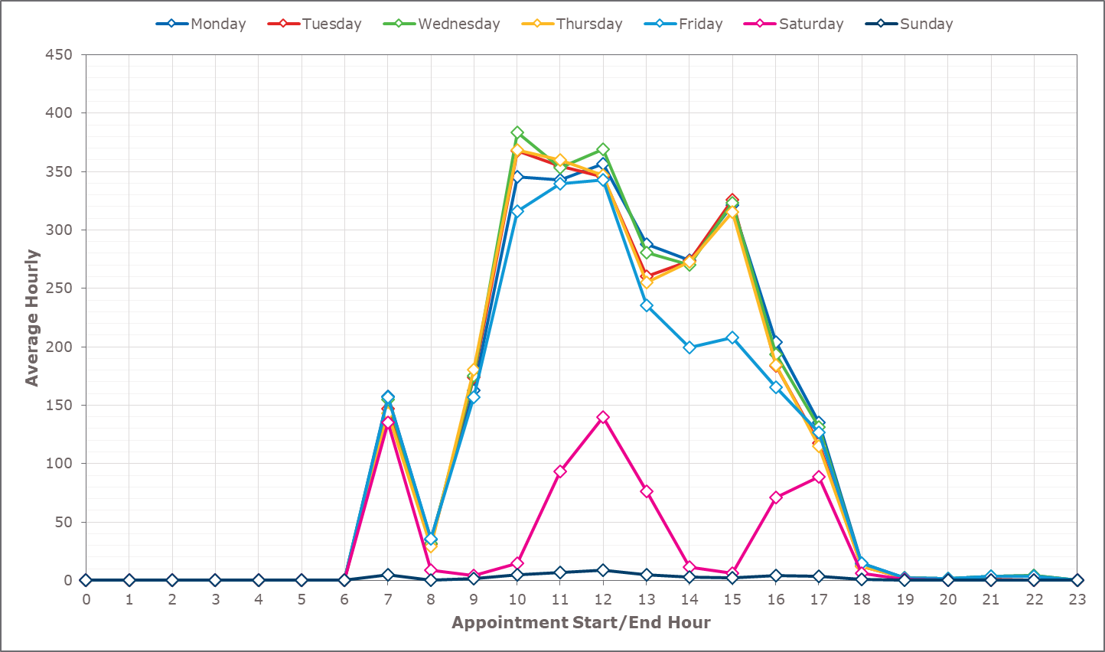
Different Demand Pattern (daytime)
Welsh Ambulance Services NHS Trust

Slide 5
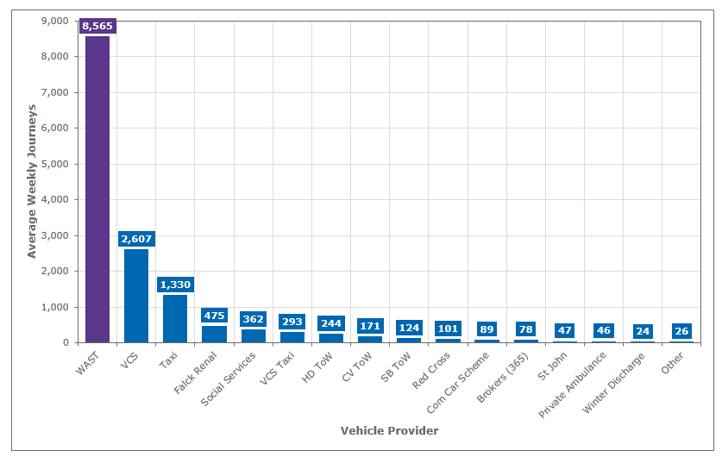
More Complex Resources (plurality model)
Five main types of WAST resource with additional capacity through plurality model.
Welsh Ambulance Services NHS Trust

Slide 6
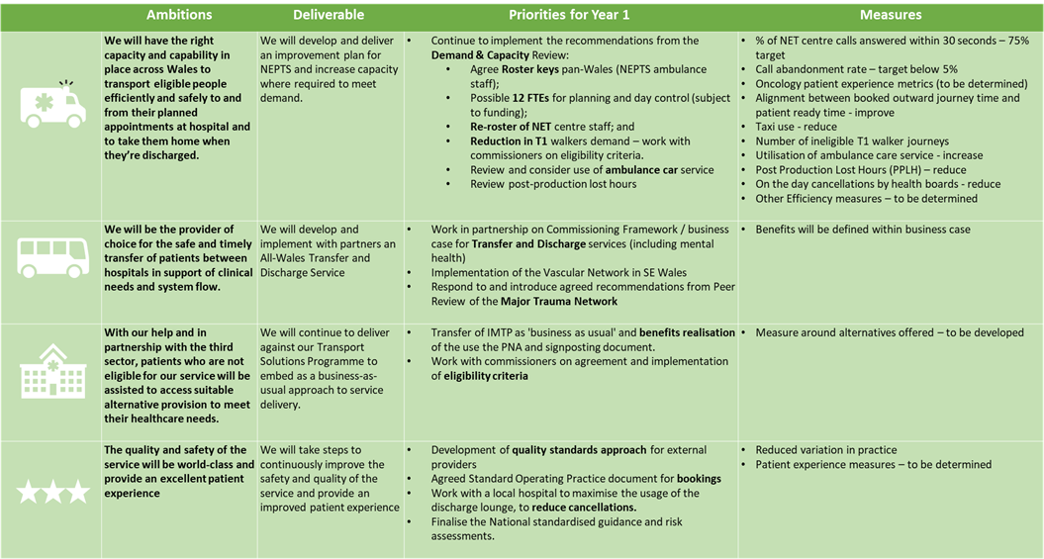
2022 – 2025 WAST IMTP
Welsh Ambulance Services NHS Trust

Slide 7
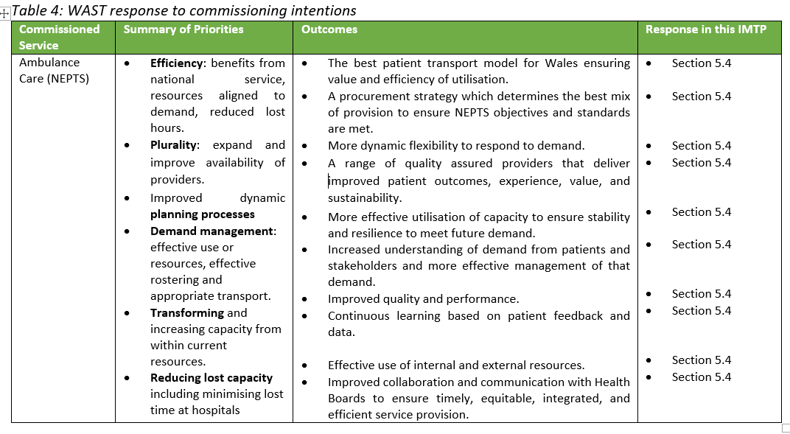
EASC NEPTS Commissioning Intentions
Background information contains full list of EASC NEPTS Commissioning Intentions
Welsh Ambulance Services NHS Trust

Slide 8
EASC NEPTS Resource Envelope
The NEPTS annual EASC Resource Envelope is circa £28m.
WAST has a historic deficit and overspend for NEPTS, caused by the use of overtime and taxis i.e. variable costs to meet demand.
This is consistent with the findings of the strategic NEPTS Demand & Capacity Review which identified a range of efficiencies (being actioned), but also an identified need of 30 FTEs to close a relief gap.
Unless EASC agrees to fund all of NEPTS core activity, mechanisms are necessary to reduce demand and match capacity.
Welsh Ambulance Services NHS Trust

Slide 9
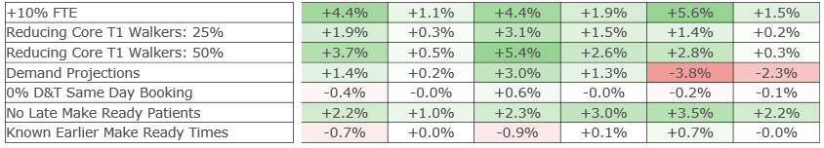
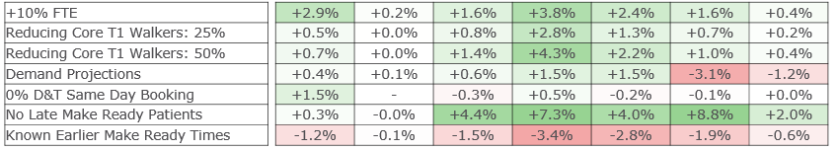
NEPTS Modelled Efficiencies
Inbound Modelled Efficiencies
In 2021 WAST undertook an independent collaborative NEPTS Demand & Capacity Review.
The modelling clearly illustrates the efficiency gains that can be achieved through demand management and also by aligning patient ready times at clinics with vehicle availability.
WAST needs health board support to deliver these.
Outbound Modelled Efficiencies
Welsh Ambulance Services NHS Trust

Slide 10
Transformation: Ambulance Care (NEPTS) Programme
Welsh Ambulance Services NHS Trust

Slide 11
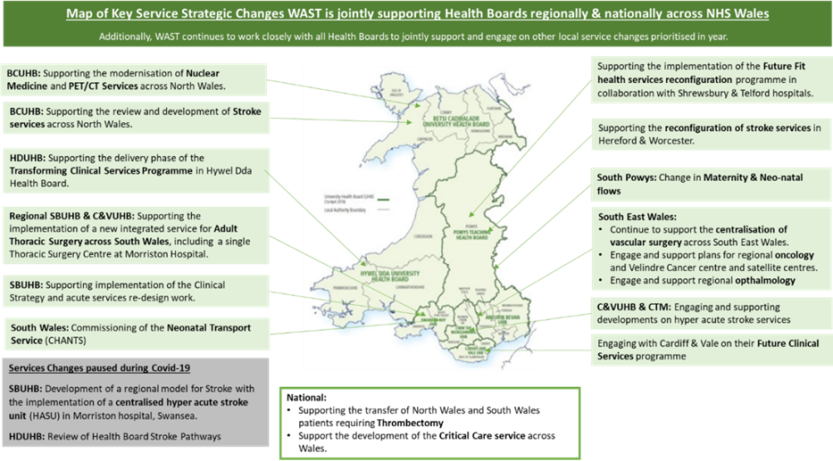
Health Board Strategic Reconfigurations
Most strategic reconfigurations have patient transport implications.
WAST has access to powerful simulation software.
Lessons from the GUH include: early engagement, use of software and timely agreement on transport model.
Good example of this currently in HD.
Critical to patient flow.
Welsh Ambulance Services NHS Trust

Slide 12
National Discharge & Transfer Service
Drivers
WAST Strategic ambition – “Provider of choice”
An IMTP commitment for WAST and EASC
Increasing demand for inter hospital transfer due to major service reconfigurations and local service changes e.g.
Clinical Futures and the opening of The Grange University Hospital in Aneurin Bevan
Major Trauma Network in South Wales and South Powys
Development of hyper acute stroke services across Wales
Vascular centralisation north and south
South Wales Thoracic surgery business case
Thrombectomy growth
Hywel Dda and C&V strategic plans
Neonatal transport commissioning
WAST are already delivering a quality discharge & transfer service for ABUHB
Welsh Ambulance Services NHS Trust
Notes:
Talk about Estelle’s Directorate, maybe also mention here that the Patient Engagement teams sits in the Quality and Nursing Directorate
Introduce the team and what their main focus is
How to contact us, both in and out of hours

Slide 13
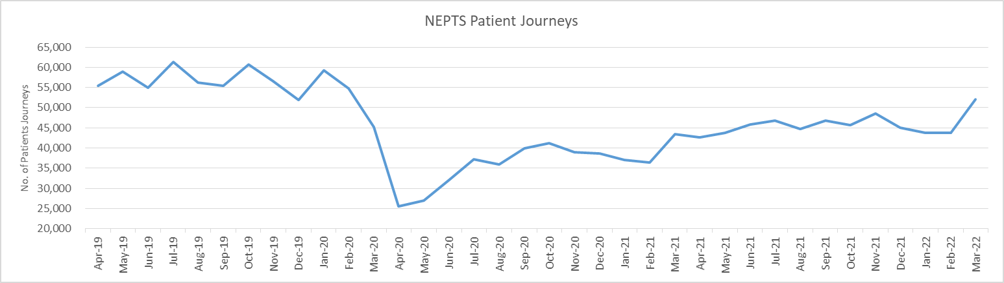
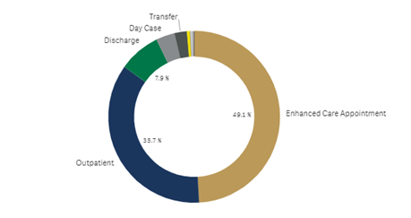
CoVID-19 & Patient Demand
Patient demand is approximately 90% of pre-pandemic levels.
But saw a sharp increase in Mar-22.
And whilst demand is lower, capacity has been reduced as a result of social distancing by as much as 45%.
49% of patient demand is enhanced care appointments, 36% is outpatient and only 8% discharge and transfer.
Welsh Ambulance Services NHS Trust

Slide 14
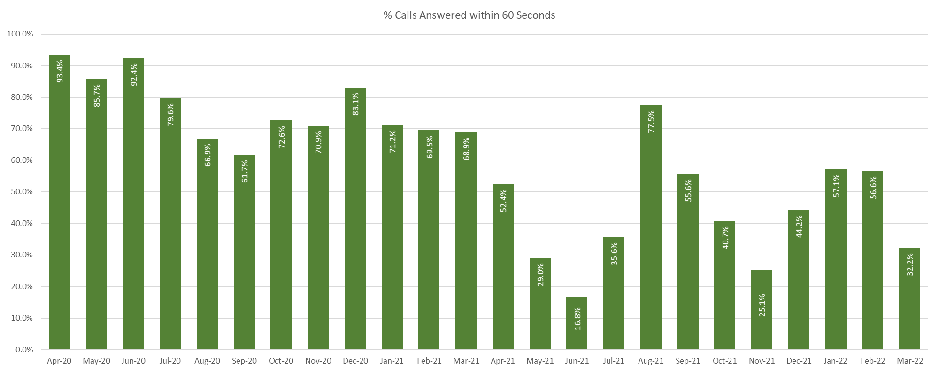
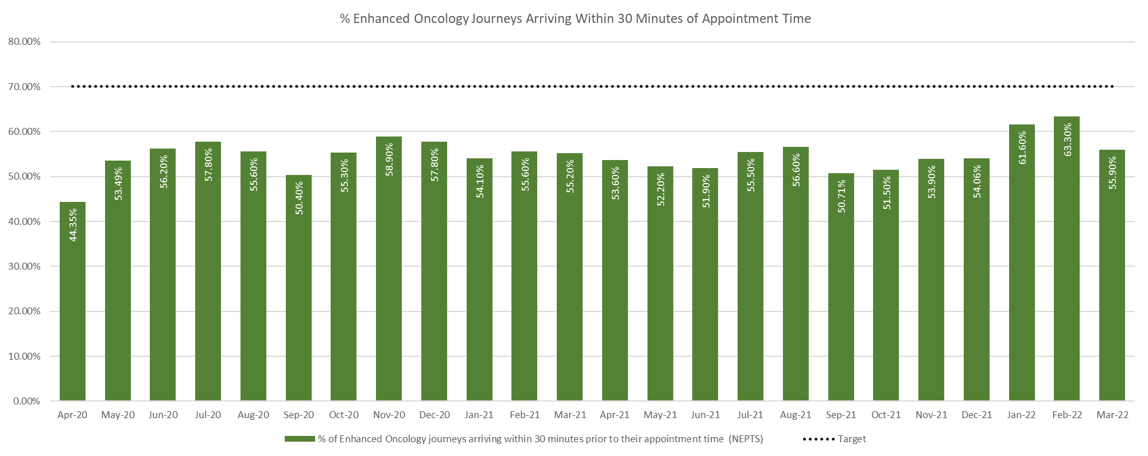
Current Performance Issues
Eligibility for NEPTS transport is based on the WHC 2007(005). The WHC is out of date and without significant resource investment is difficult to apply meaningfully and equitably.
There is no requirement to prove eligibility for NEPTS transport. Currently non-eligible patients bookings are taken on a provisional basis and conveyed where capacity allows.
There is a mismatch between demand and capacity. We either need to reduce demand or increase capacity. There are a range of options, e.g. signposting patients to alternative transport services, a more robust application of the eligibility criteria etc.
Call taking performance is being addressed currently, oncology also, but oncology may require a change of performance standard.
Welsh Ambulance Services NHS Trust

Slide 15
Background Information
- Performance -
Welsh Ambulance Services NHS Trust

Slide 16
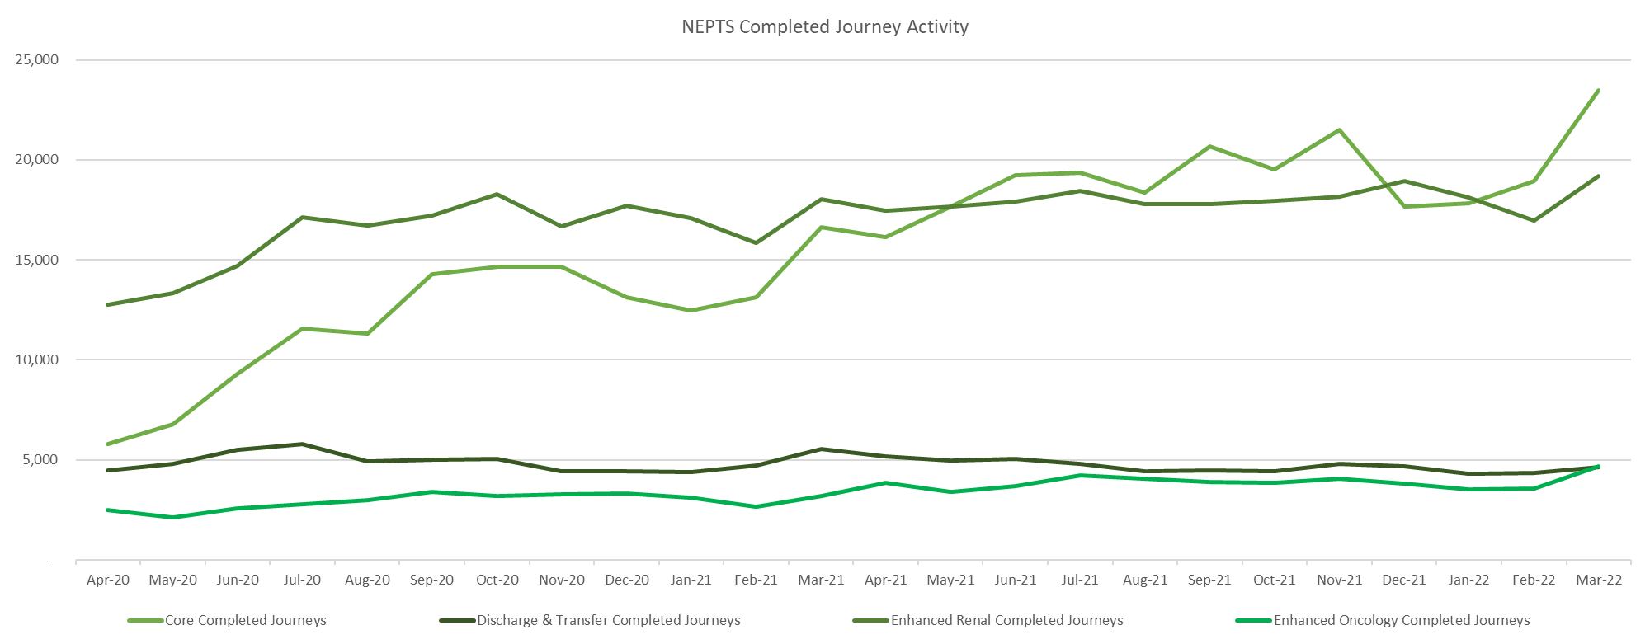
Our Patients: Quality, Safety & Patient Experience
Ambulance Care
Welsh Ambulance Services NHS Trust

Slide 17
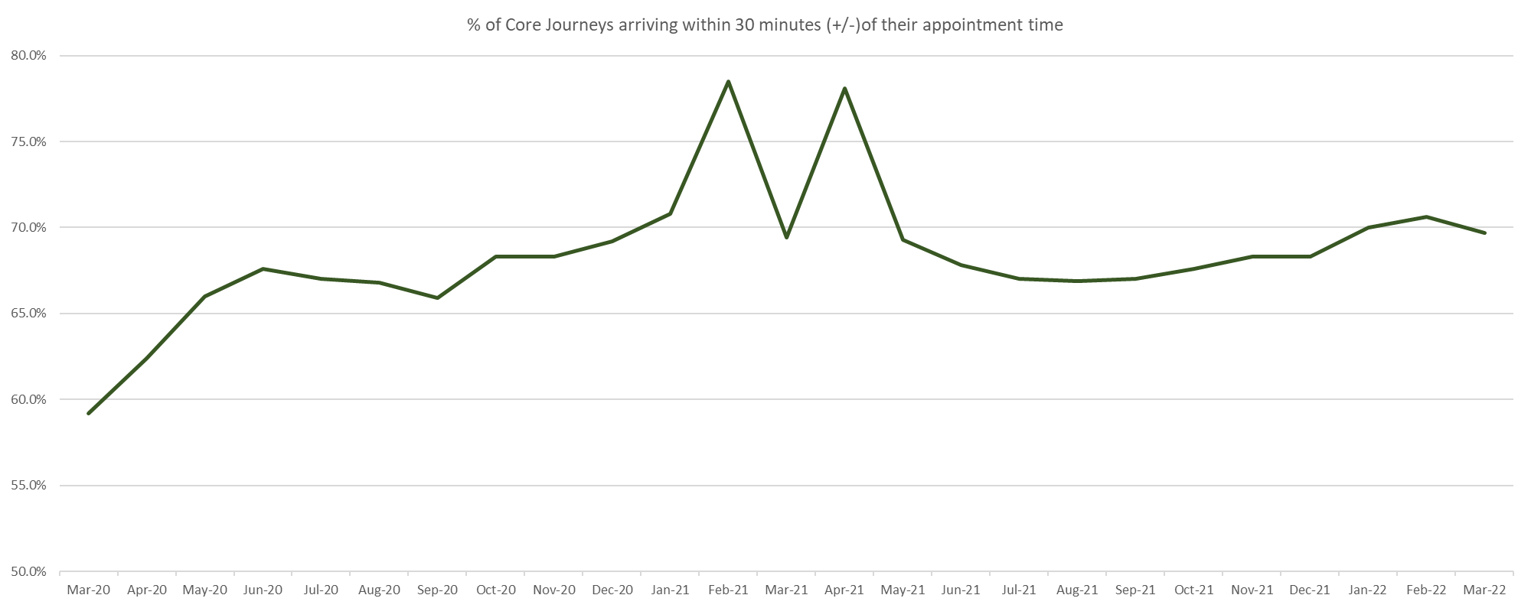
Our Patients: Quality, Safety & Patient Experience
Ambulance Care
Welsh Ambulance Services NHS Trust

Slide 18
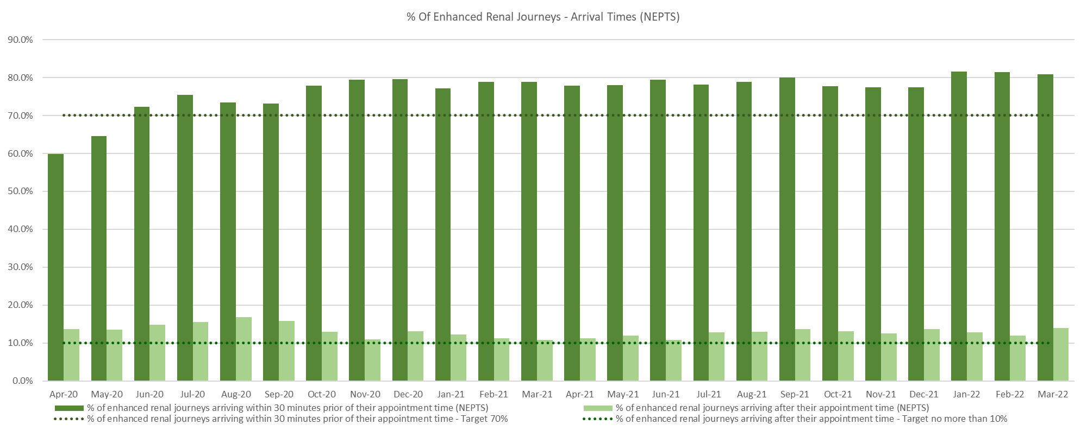
Our Patients: Quality, Safety & Patient Experience
Ambulance Care
Welsh Ambulance Services NHS Trust

Slide 19

Our Patients: Quality, Safety & Patient Experience
Ambulance Care
Welsh Ambulance Services NHS Trust

Slide 20
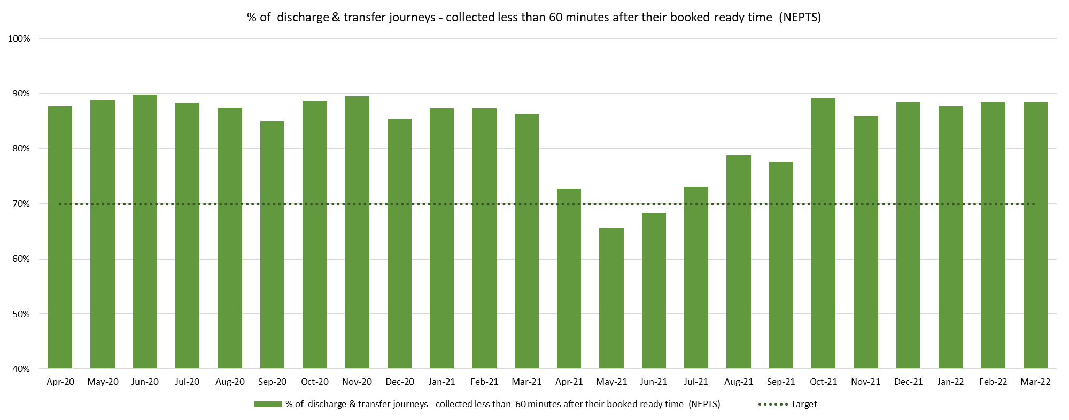
Our Patients: Quality, Safety & Patient Experience
Ambulance Care
Welsh Ambulance Services NHS Trust

Slide 21
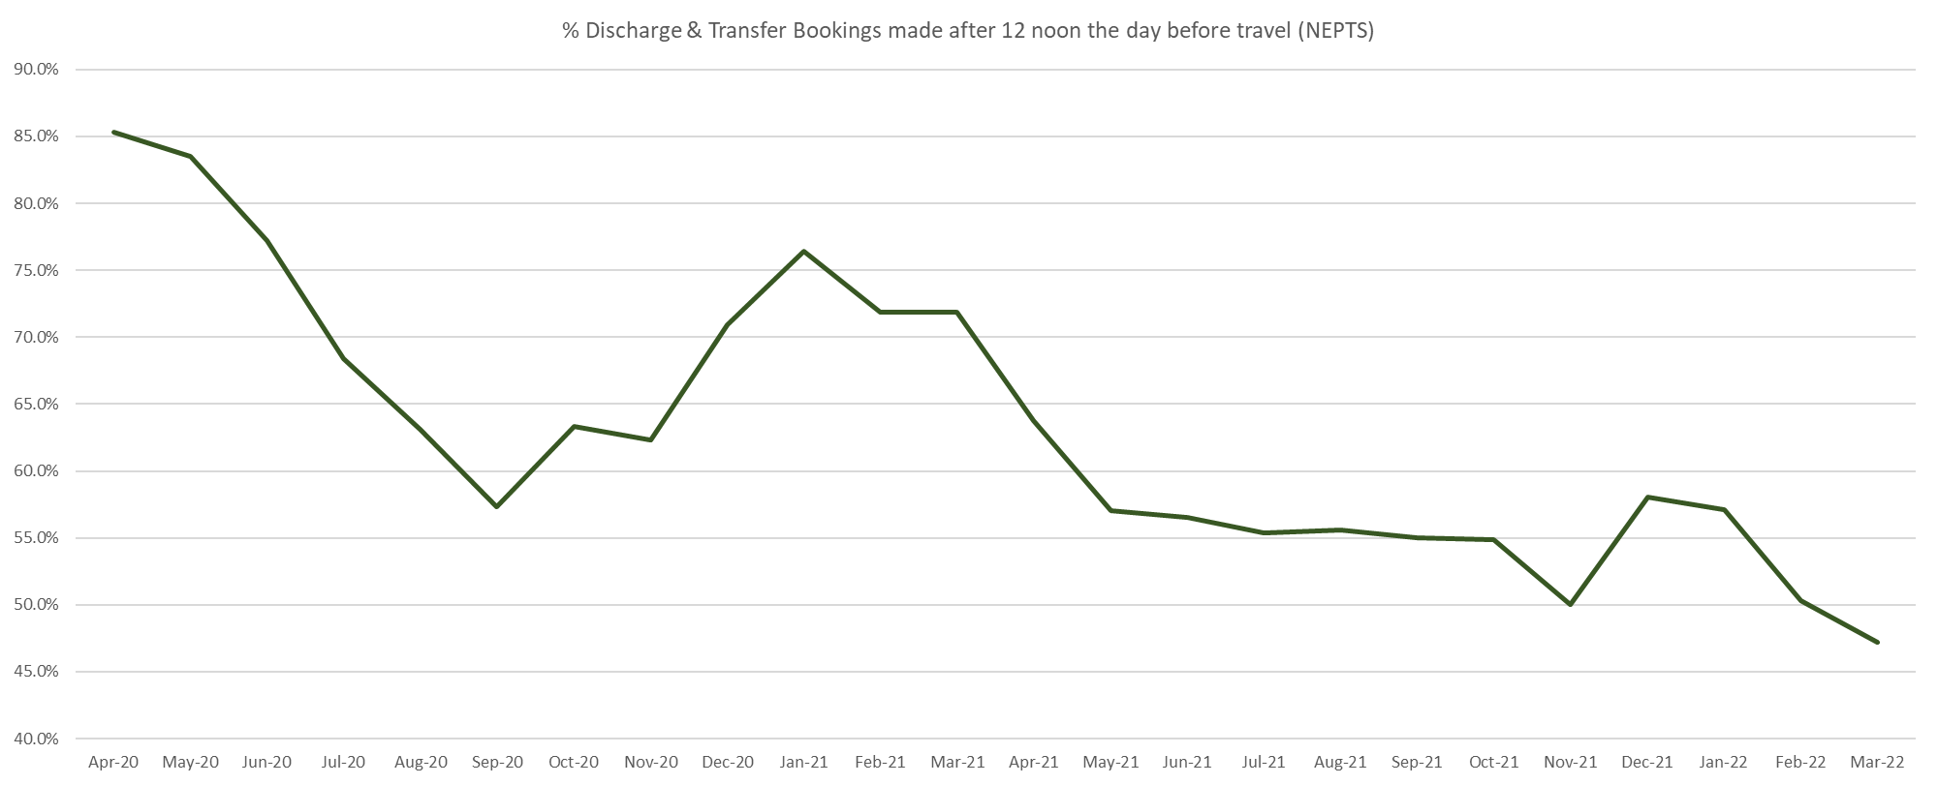
Value / Partnerships & System Contribution
Ambulance Care
Welsh Ambulance Services NHS Trust

Slide 22
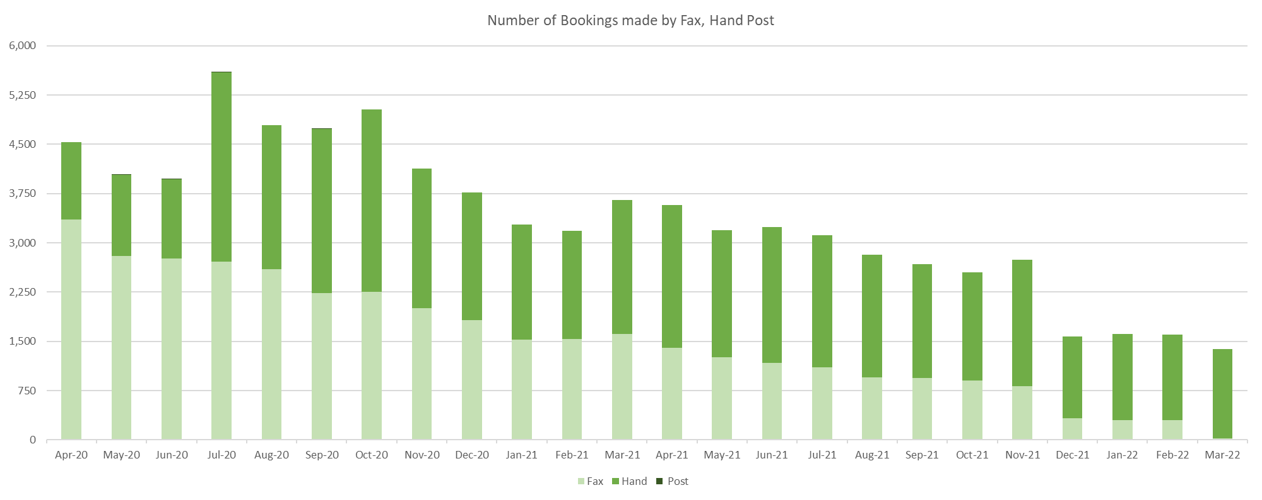
Value / Partnerships & System Contribution
Ambulance Care
Welsh Ambulance Services NHS Trust

Slide 23
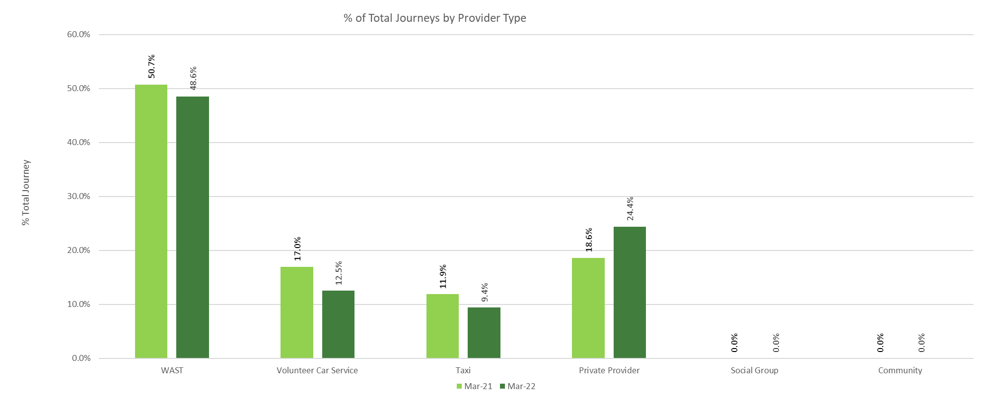
Value / Partnerships & System Contribution
NEPTS –Journeys by Provider Type
Welsh Ambulance Services NHS Trust

Slide 24
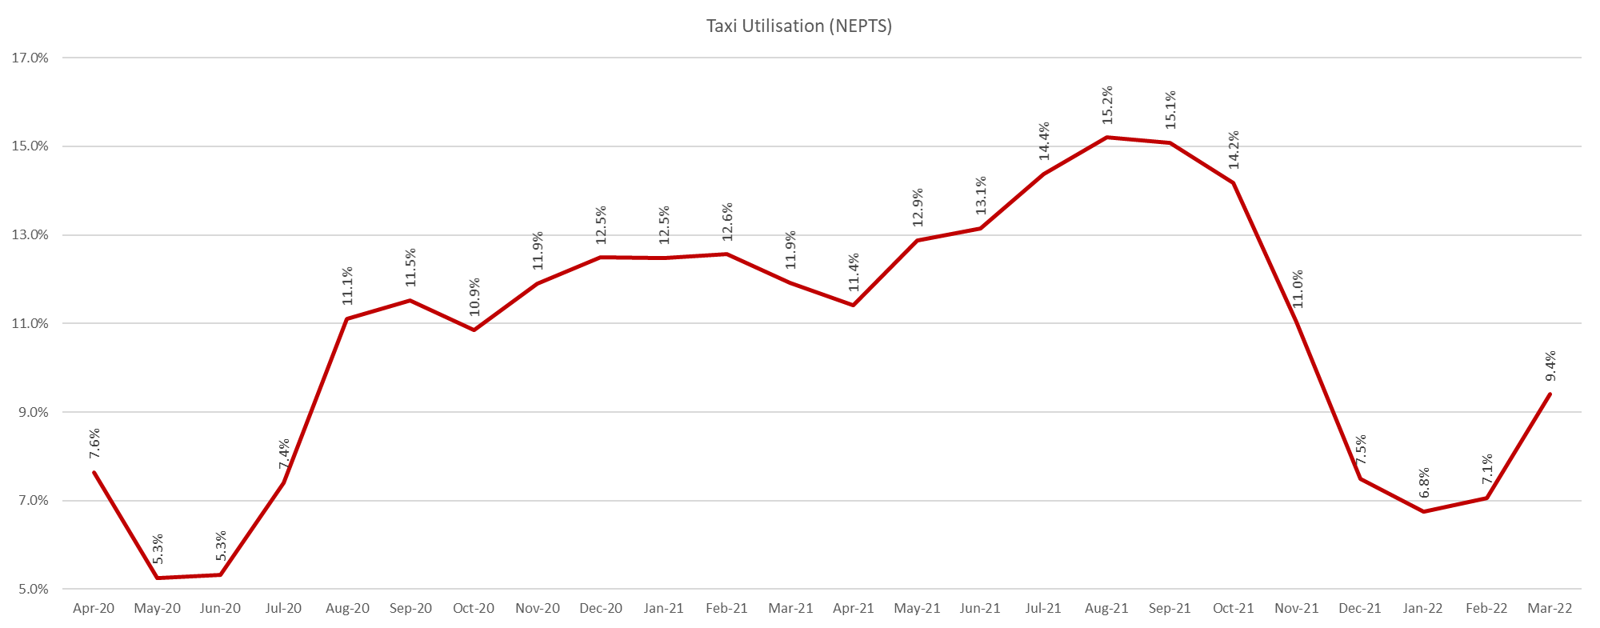
Value / Partnerships & System Contribution
NEPTS – Taxi Journeys
Welsh Ambulance Services NHS Trust

Slide 25
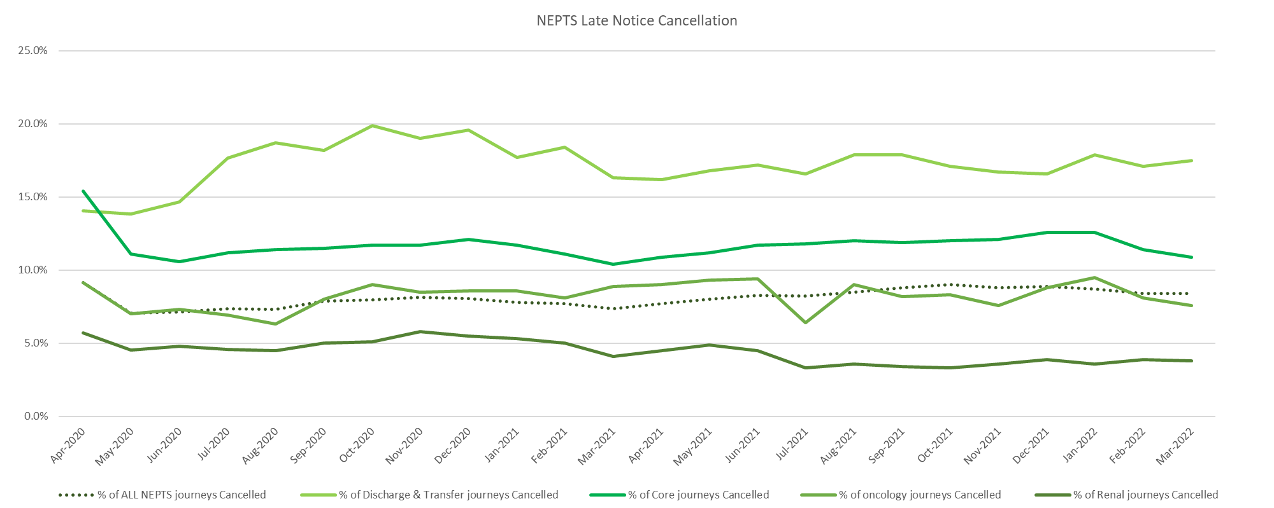
Value NEPTS – Late Notice Cancellation
Welsh Ambulance Services NHS Trust

Slide 26
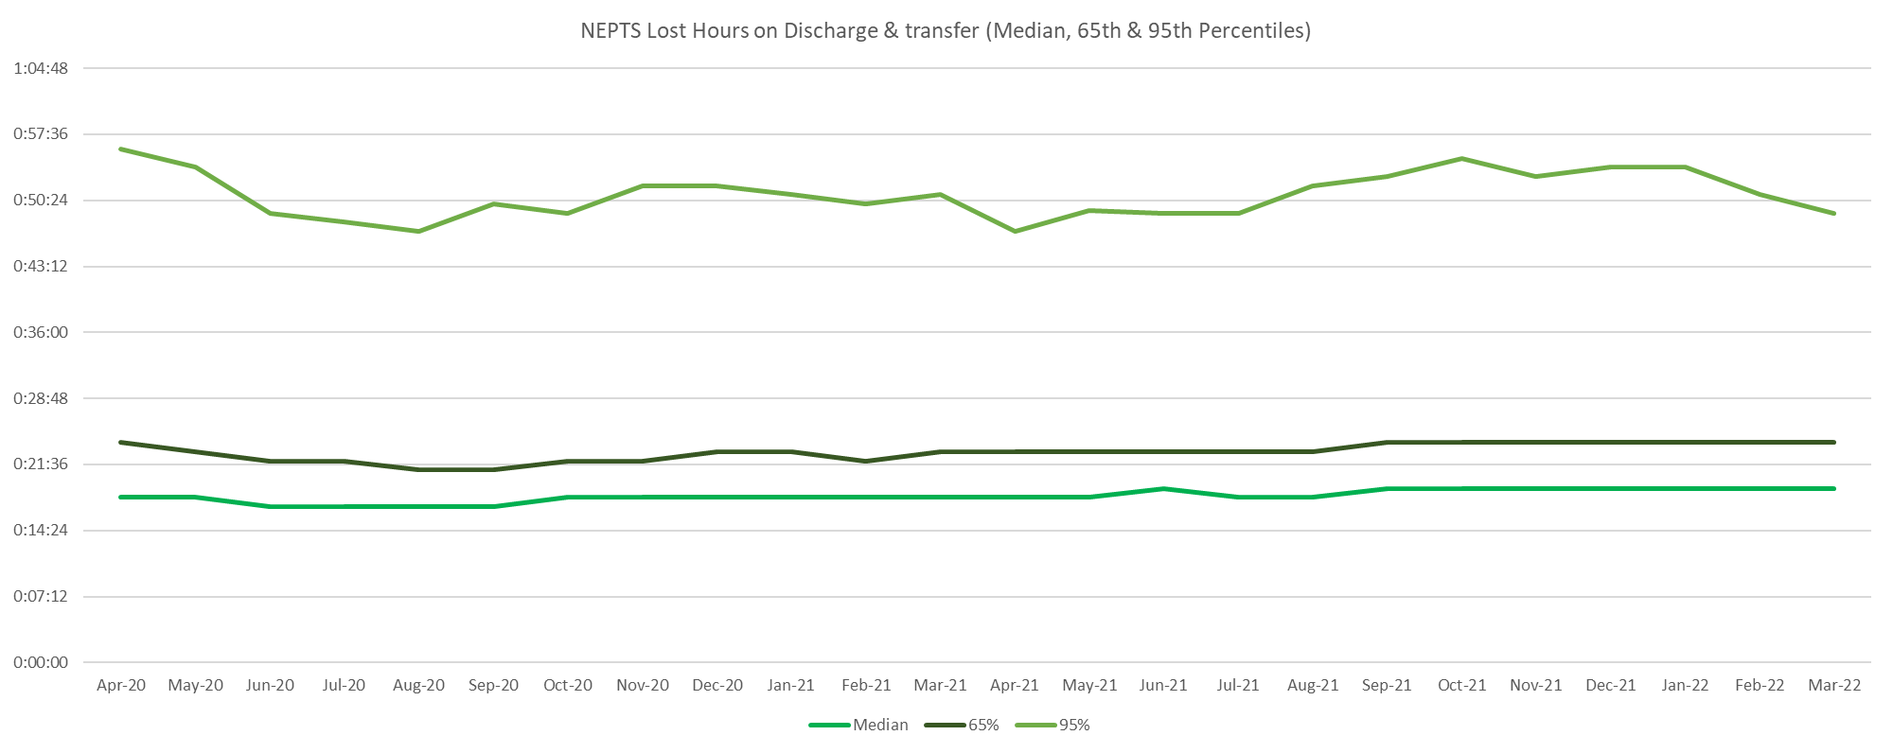
Value NEPTS – Lost Hours on Discharge & Transfers
Welsh Ambulance Services NHS Trust

Slide 27
Background Information
- EASC NEPTS Commissioning Intentions -
Welsh Ambulance Services NHS Trust

Slide 28
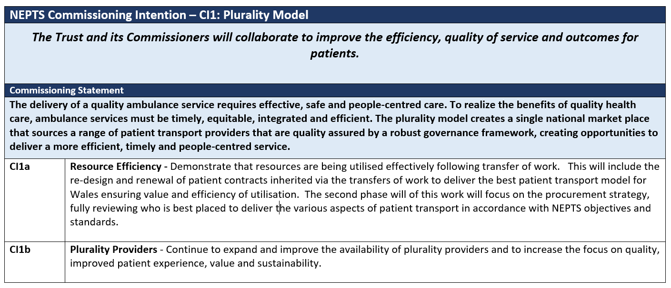
Welsh Ambulance Services NHS Trust

Slide 29
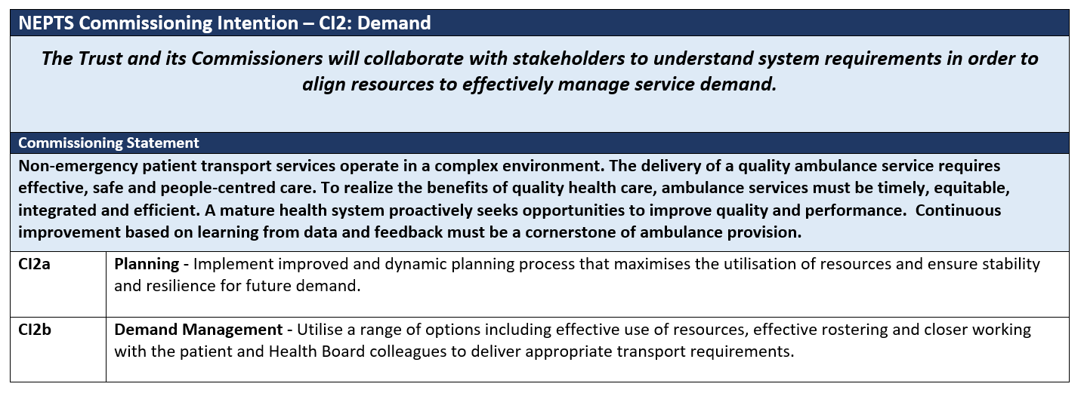
Welsh Ambulance Services NHS Trust

Slide 30
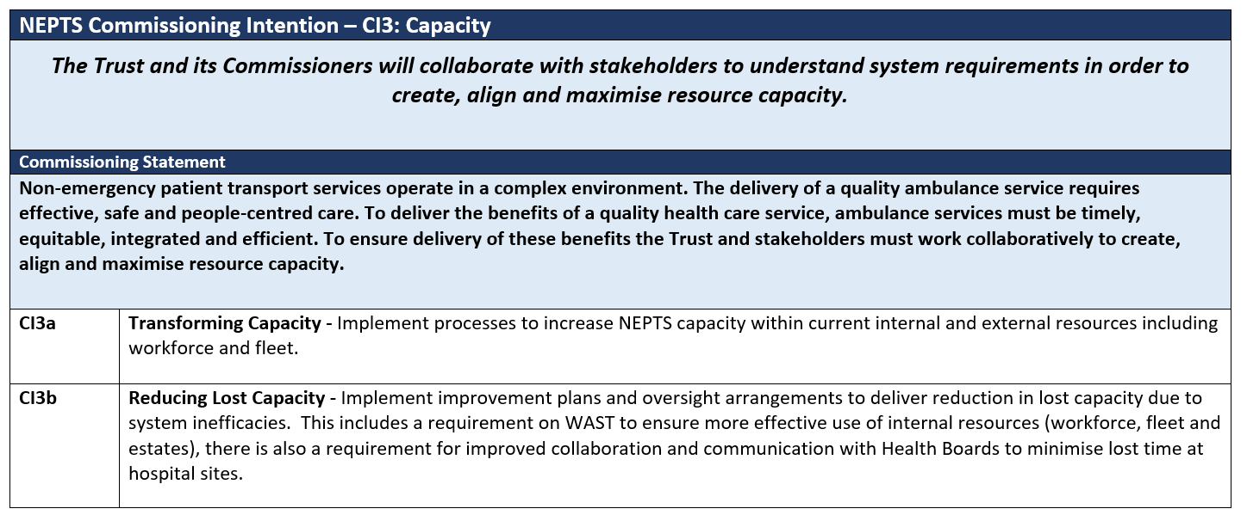
Welsh Ambulance Services NHS Trust

Slide 31
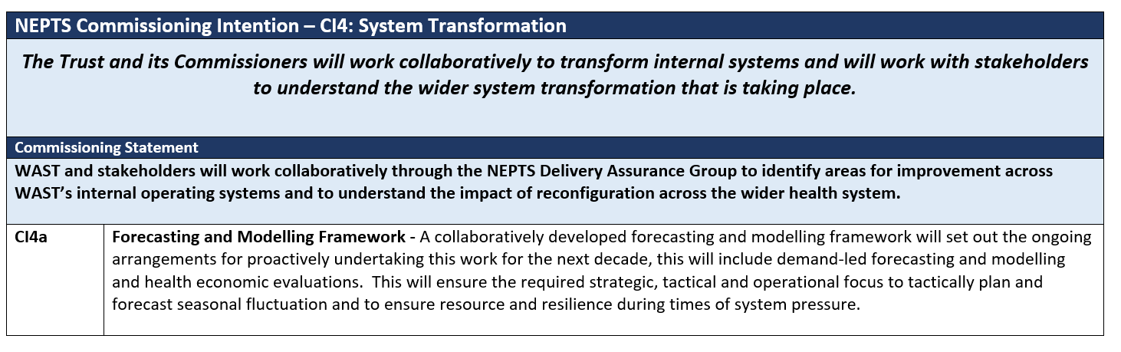
Welsh Ambulance Services NHS Trust

